Slide 1

Supported Internship Scheme

Slide 2
What is a supported internship?
A study programme specifically aimed at 16-24 year olds who have an Education Health Care Plan (EHCP) and want to move into employment but will need support to do so.
The programme consists of the following elements and follows an academic year:
Structured study programme, based primarily at an employer.
Normally last a year and includes unpaid work placements of at least 6 months.
Wherever possible they support young people into paid employment at the end of the programme.

Slide 3
But what does a supported internship look like? What will I do?
Develop employability skills.
Learn about different job roles.
Find a suitable work placement.
What next?

Slide 4
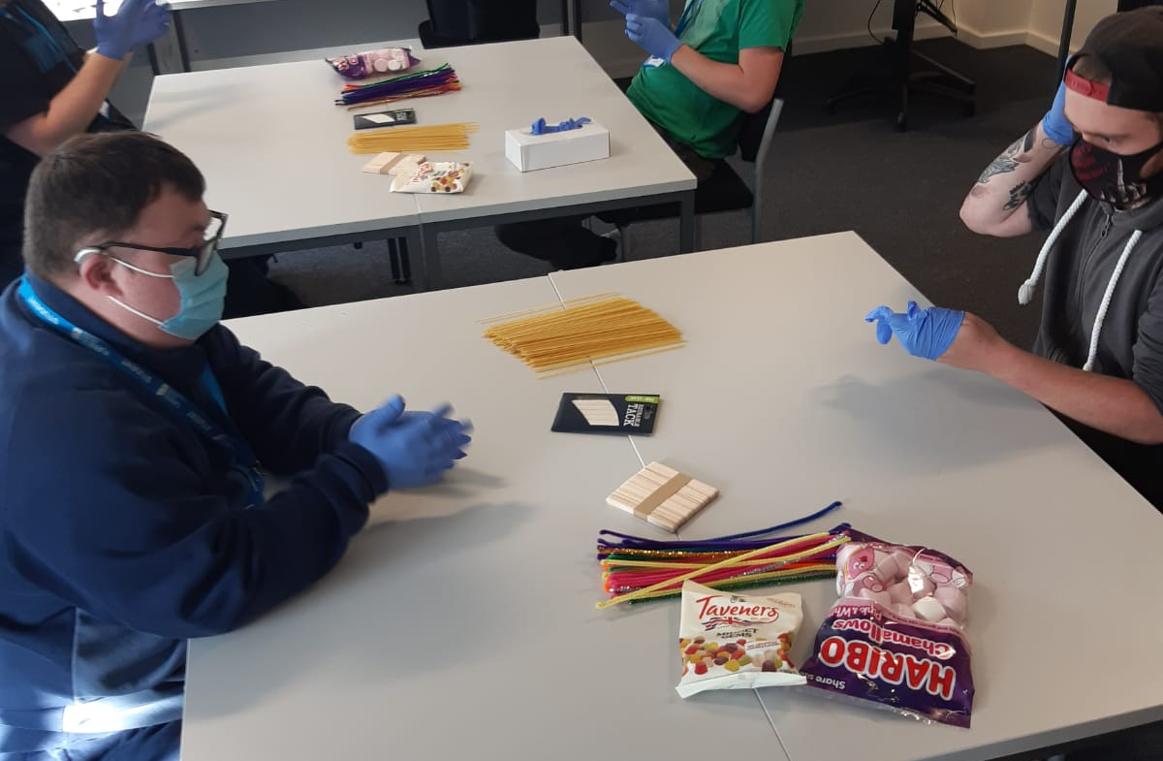
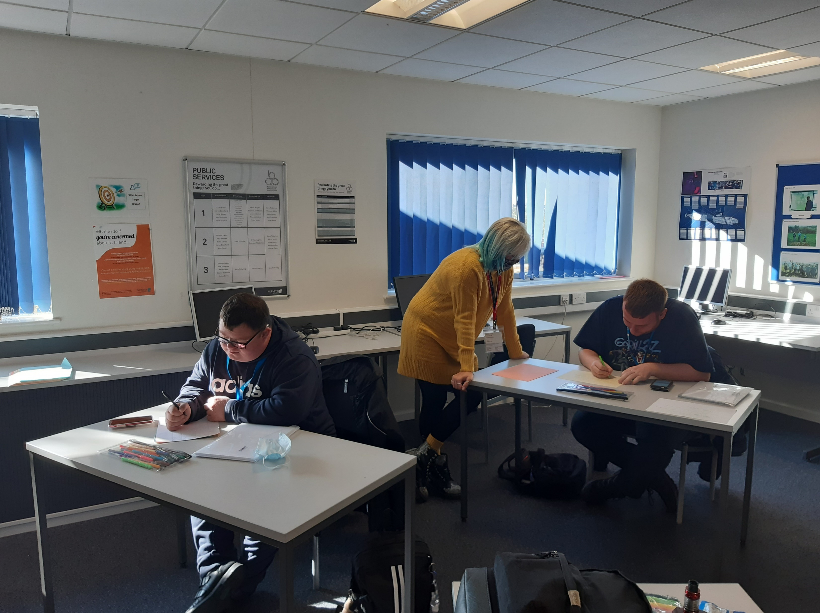
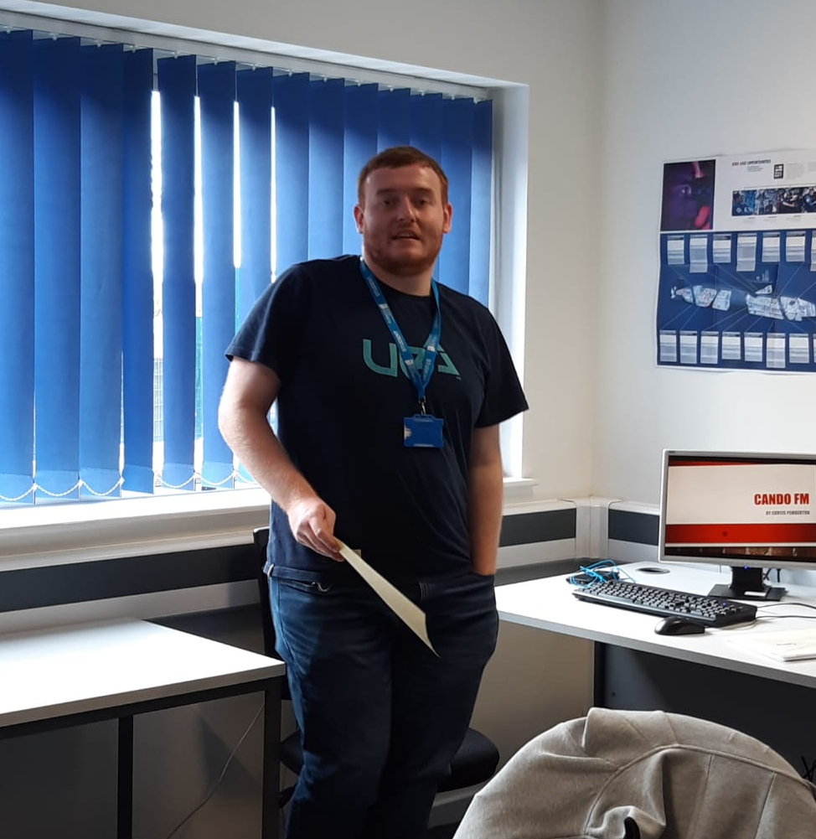
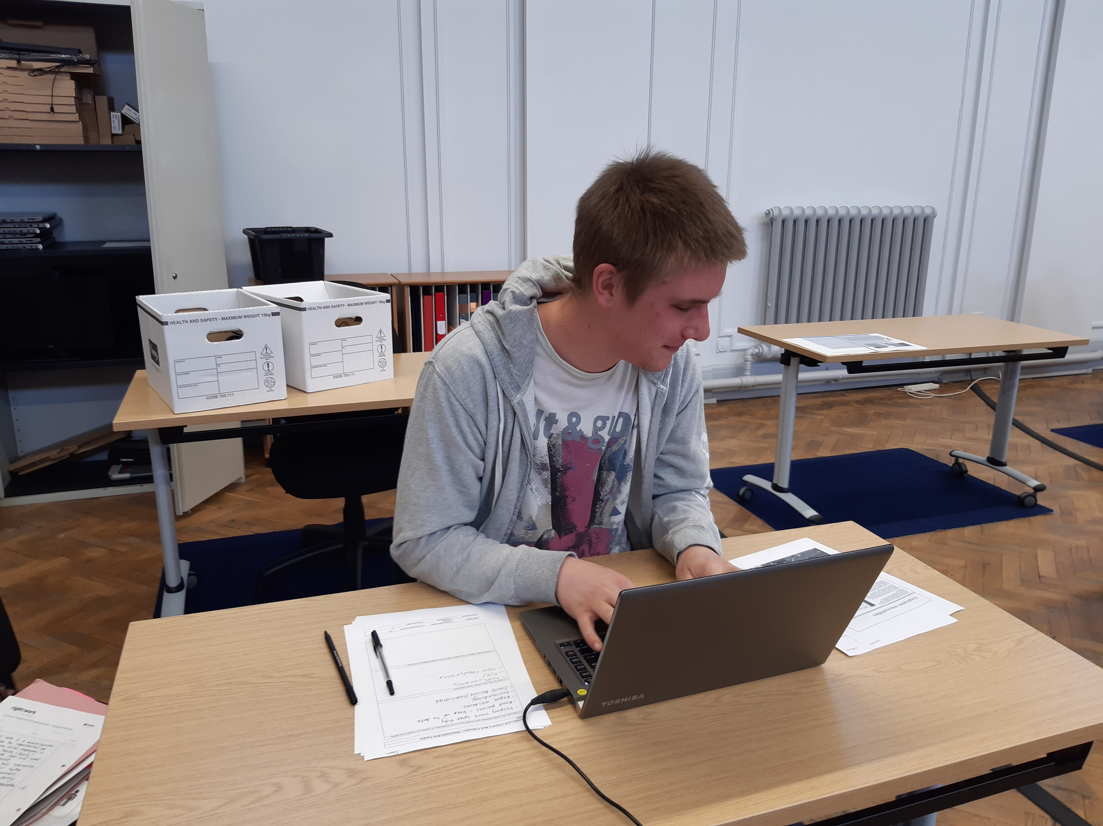
Developing team work , co-operation and problem solving skills.
Creating an up to date CV, identifying your skills and qualifications.
Employability Skills
Developing your skills in presentation and communication.
Researching job roles and career paths.

Slide 5
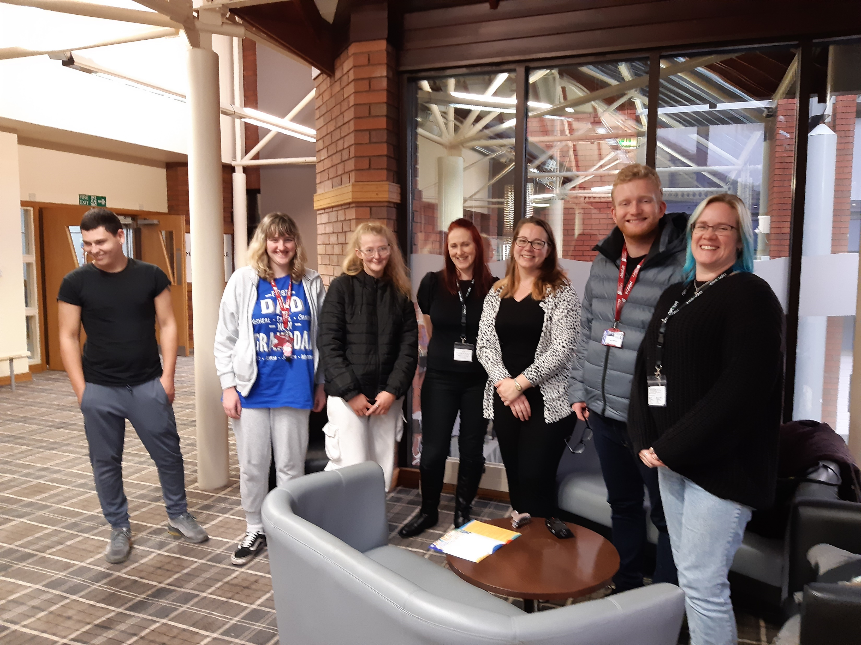
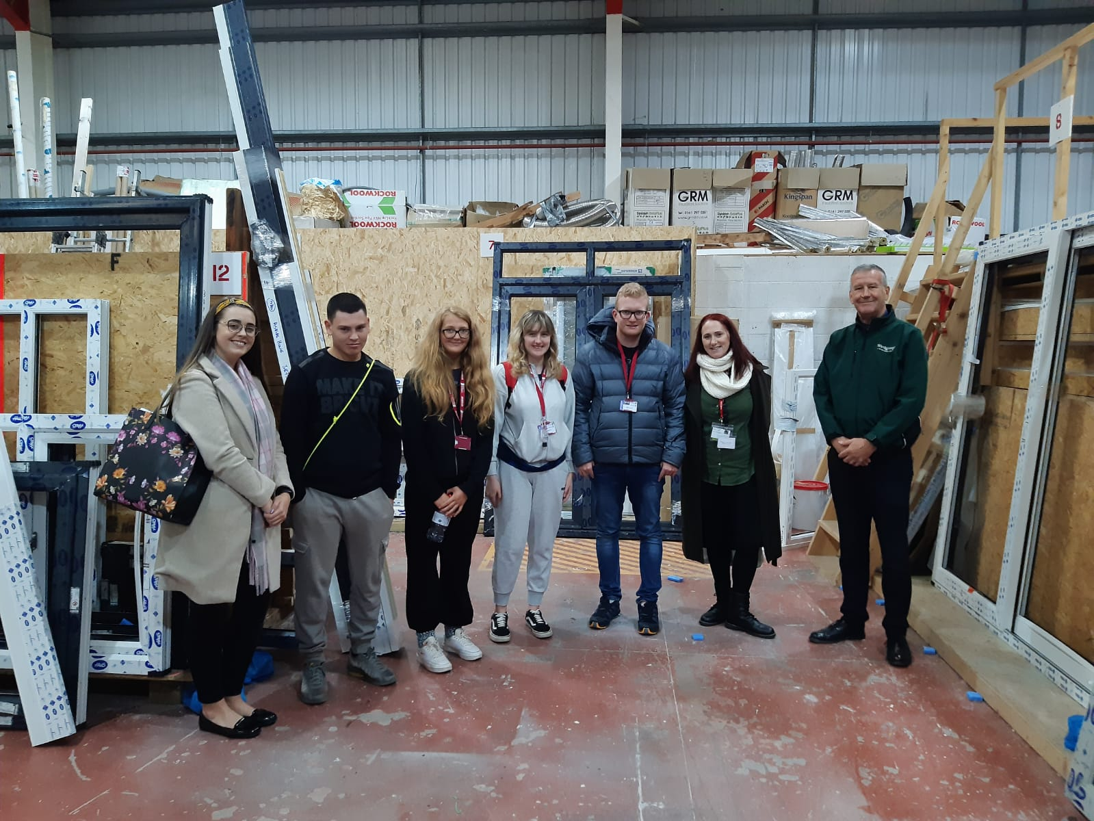
Learning about different job roles
We will organise visits to local Careers fairs to look at opportunities around our local area.
We will arrange tours of local firms to learn and discuss various job roles. Here we are having a tour of Wards in Barrow.

Slide 6



We will talk about our future goals and write down ideas.
Share our ideas and make a shortlist of desired job roles.
Find a suitable work placement
Support you to search for vacancies online.
Research various job roles and companies before we approach them.
Use national careers to identify jobs we would be suitable for linked with our skills and interests.
We will phone employers and discuss placement opportunities.
We will support you to phone for workplaces advertising opportunities.

Slide 7
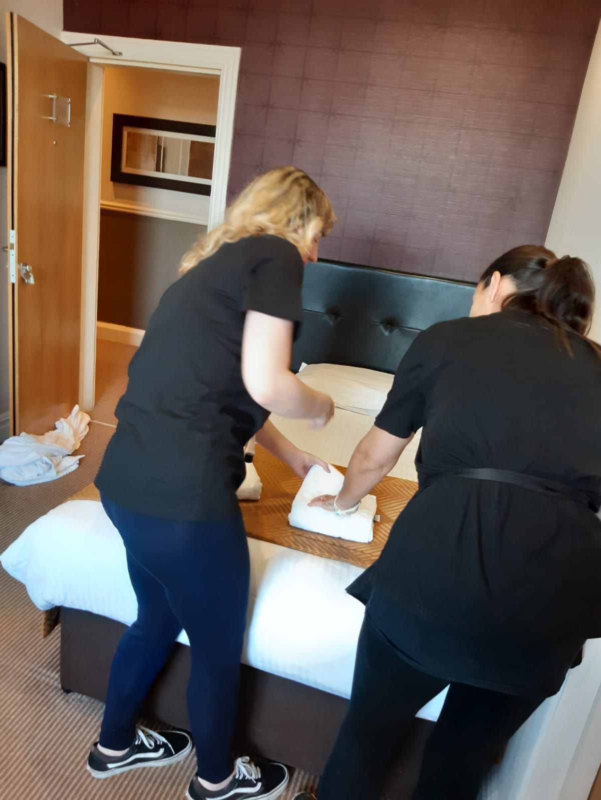
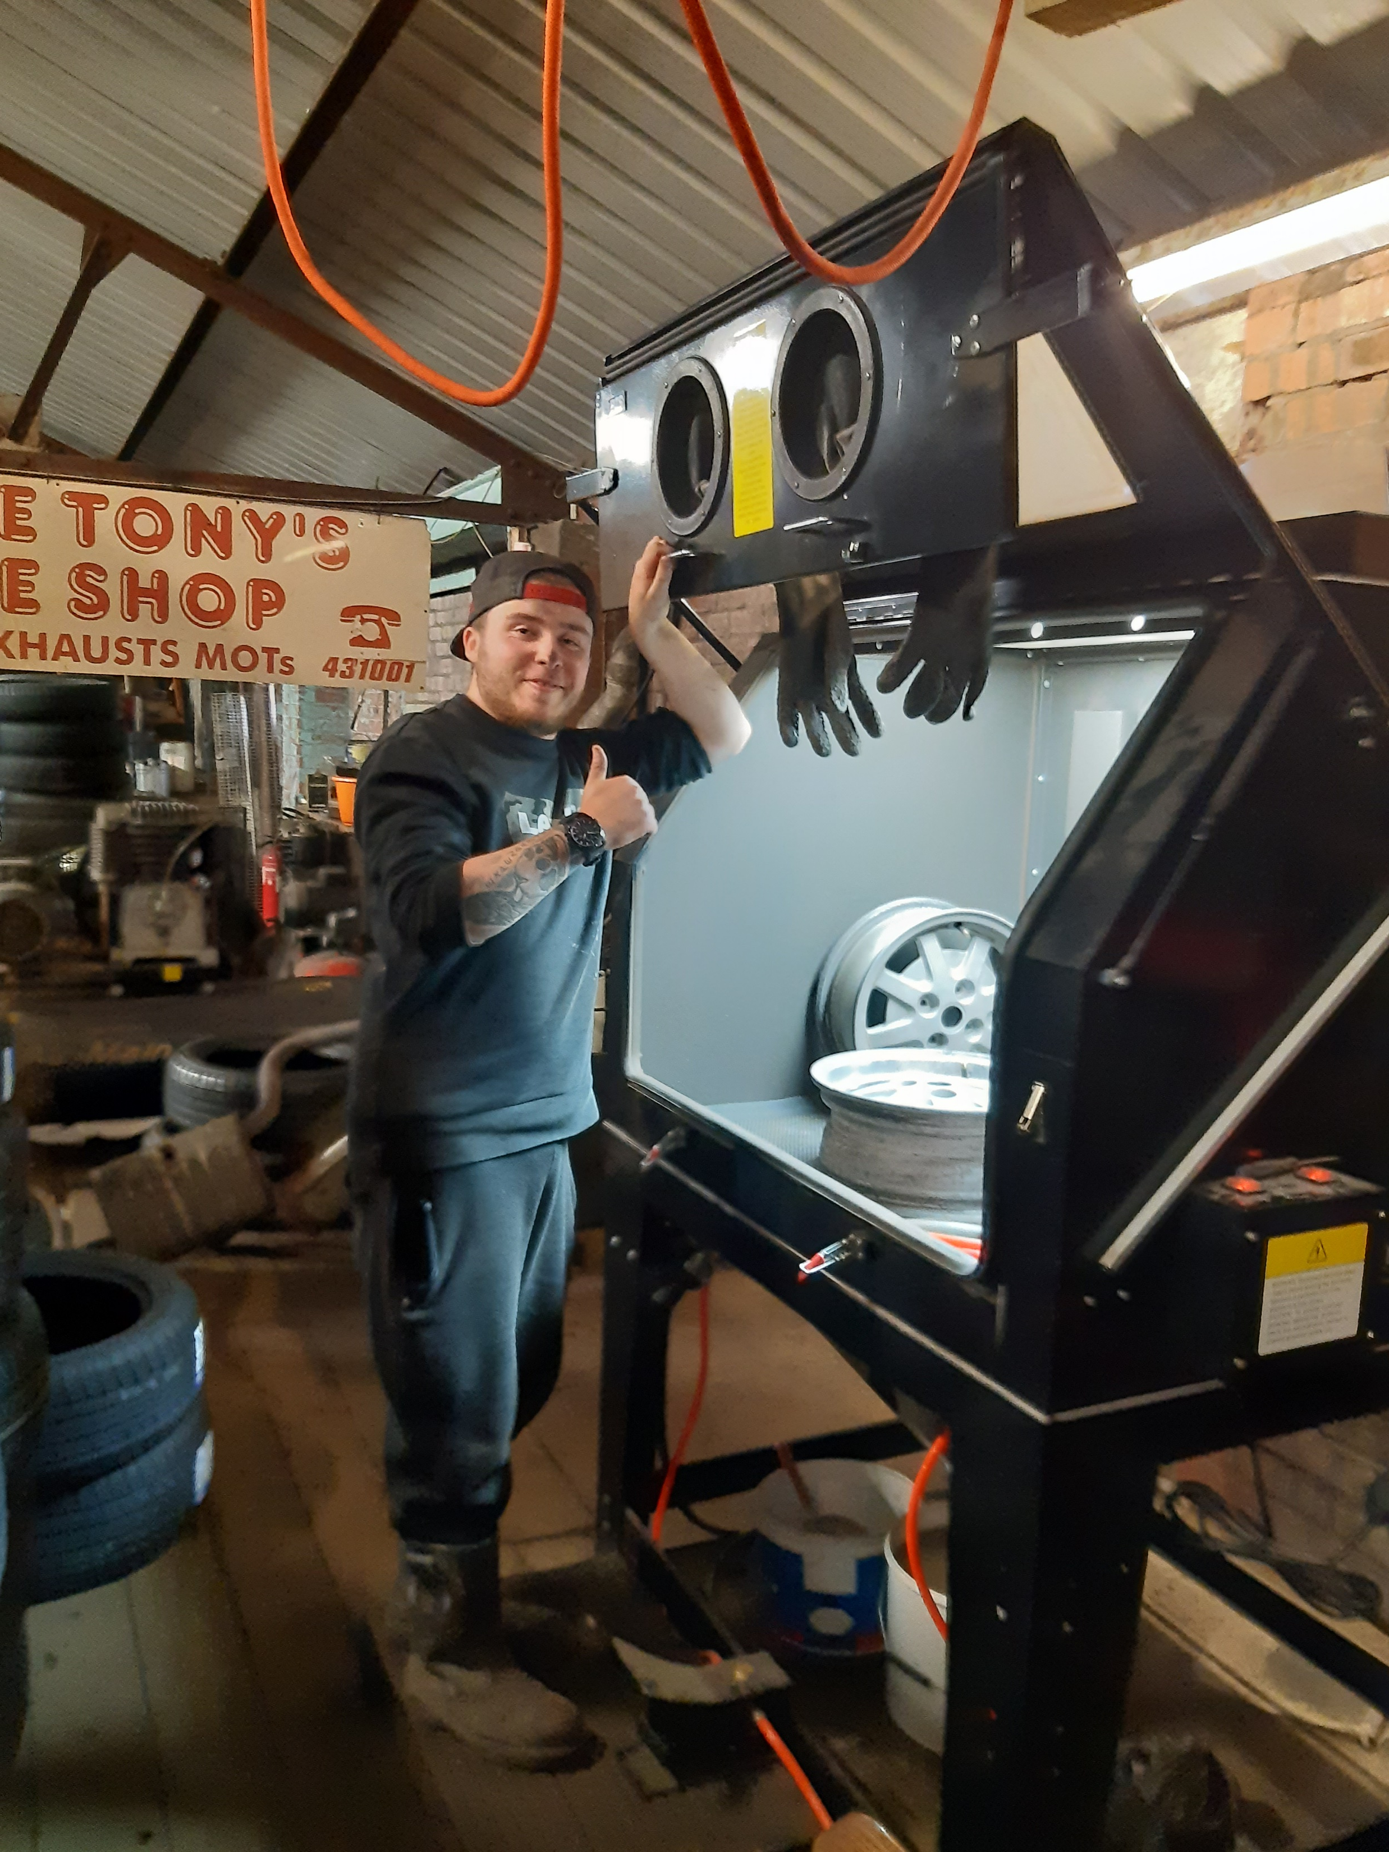
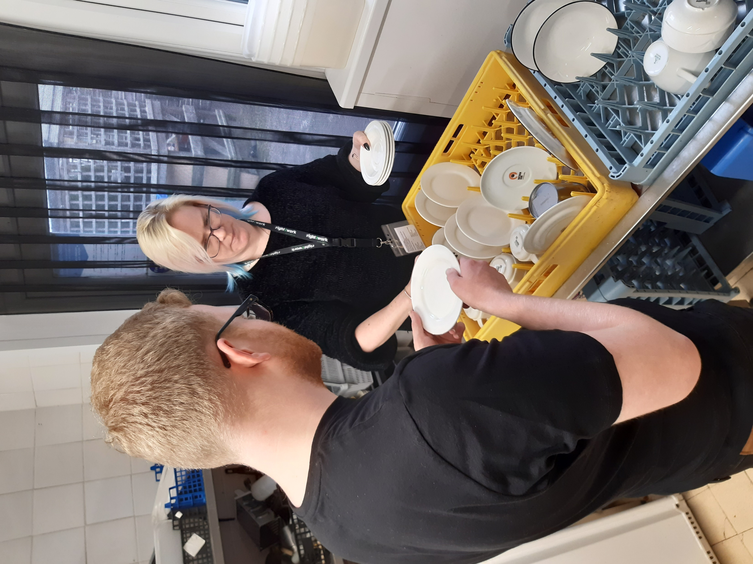
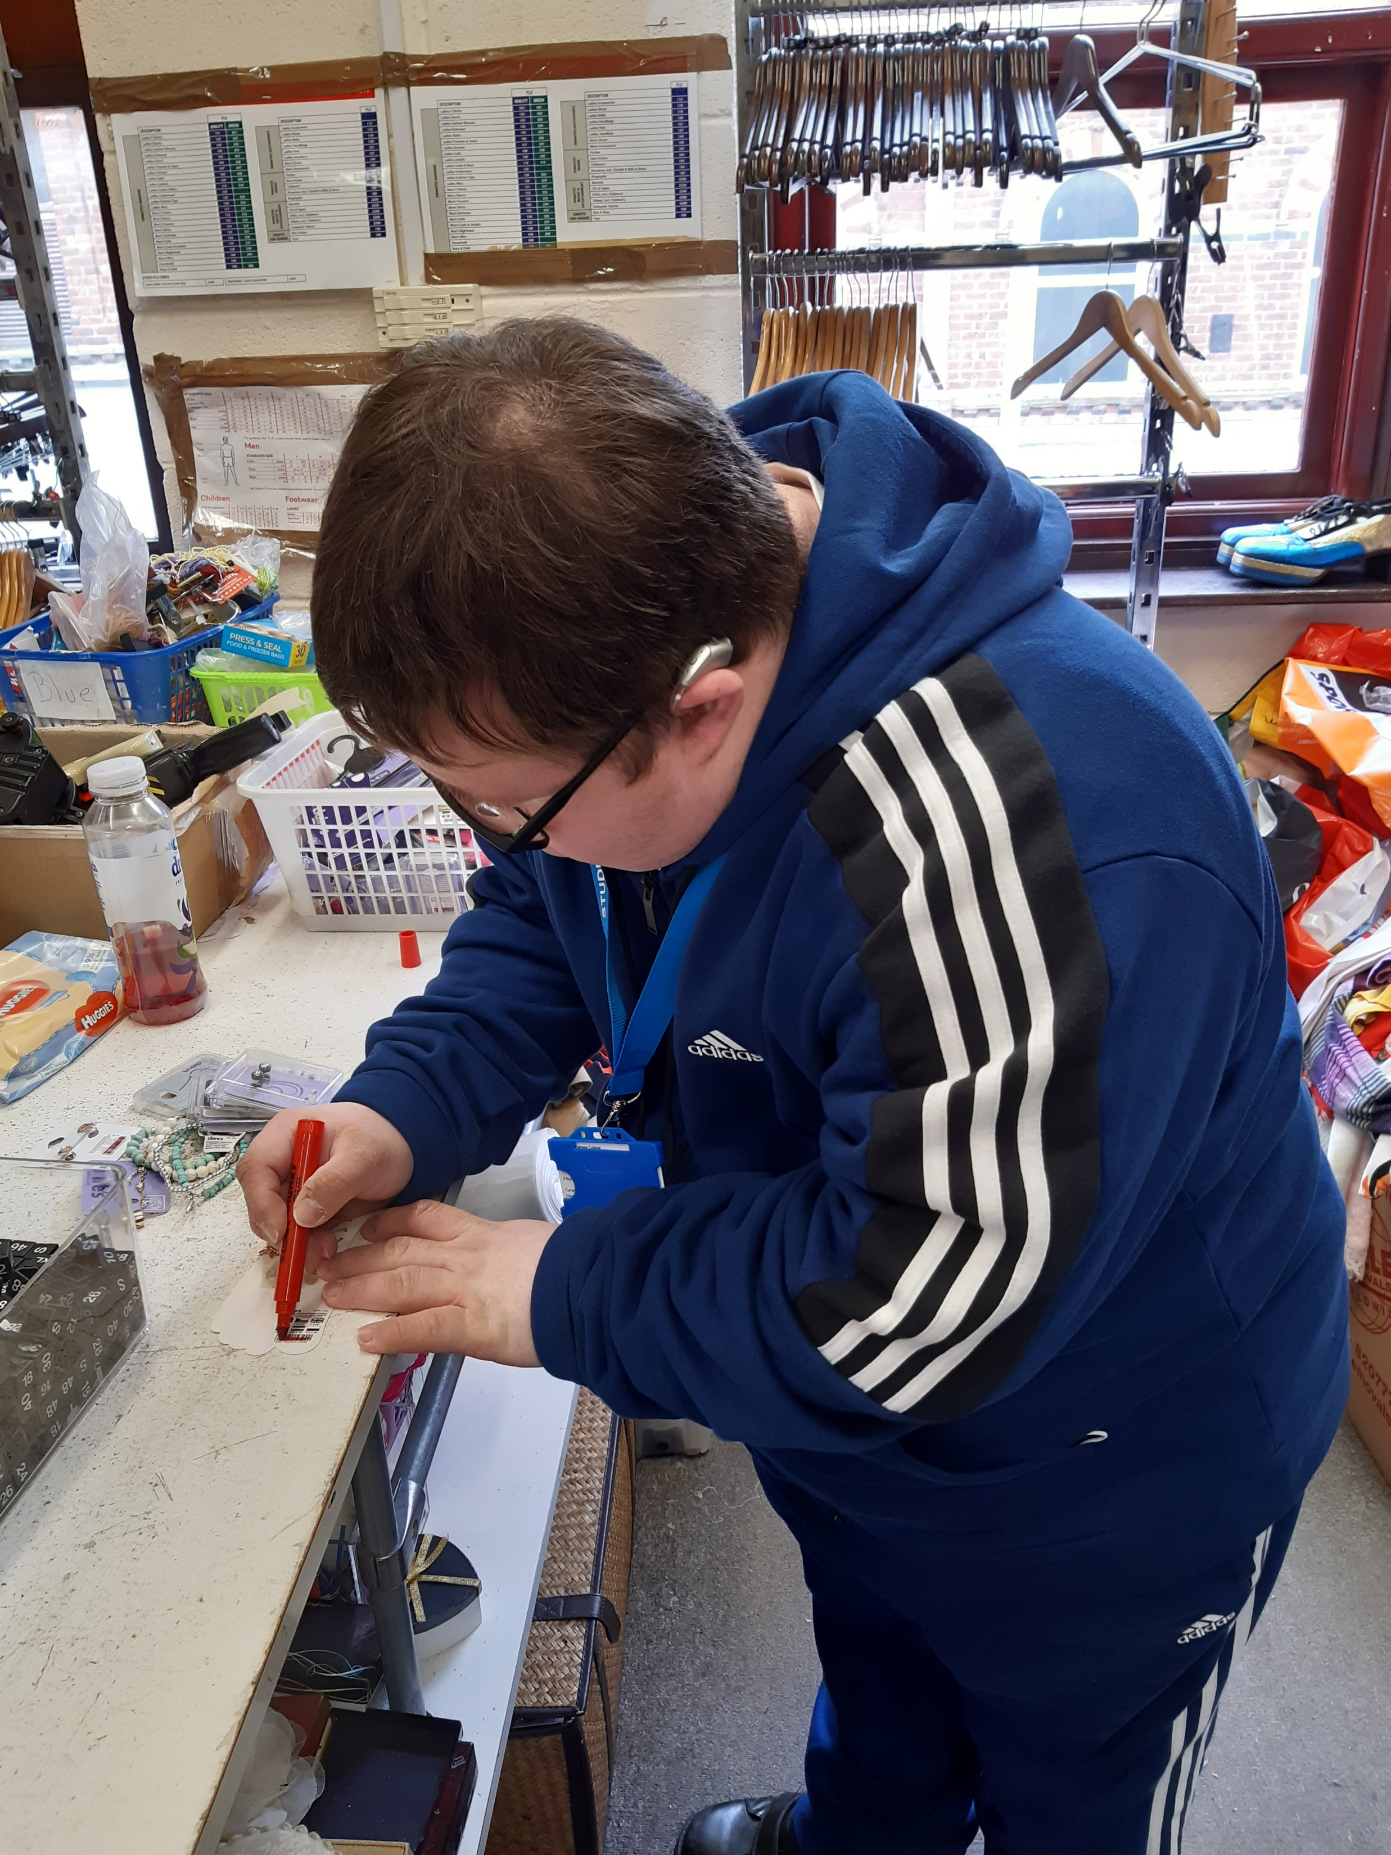
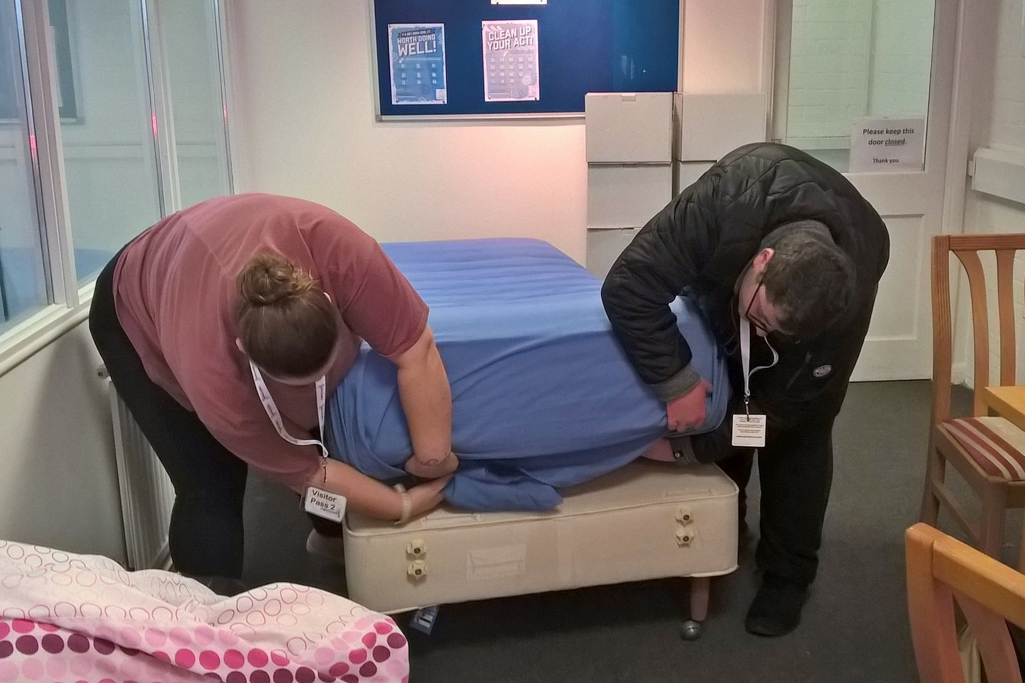
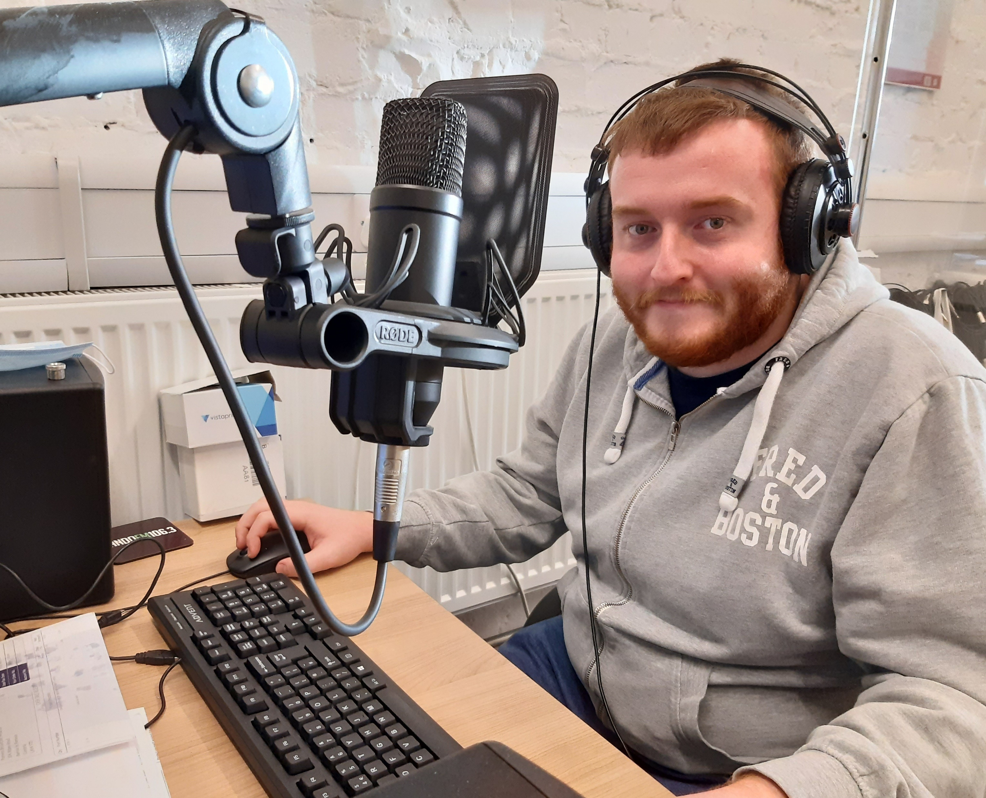
Work Placement- the work placement is a team effort. We use activities and discussion to identify suitable roles, we then contact a range of employers to arrange visits and in most cases an interview.
Here are some examples of work placements we have secured…

Slide 8
What happens next?
Work with the employer and job coach to agree working hours over 3 days
Complete an placement agreement.
Complete an induction.
Work and develop your knowledge of completing tasks independently
Job coach will support you into your role using task analysis

Slide 9

Next steps…..
Throughout the year you will have termly reviews led by your job coach.
This is a chance to celebrate your achievements, plan your next targets and a chance for parent/carers to see- through photographs- and get feedback about your supported internship.
These reviews will also give you the opportunity to identify your achievements and skills you have developed meaning you can update your CV.

Slide 10
End of the supported internship
Many of our learners gain paid employment. Having been in a placement and developed skills ‘hands on’.

Slide 11
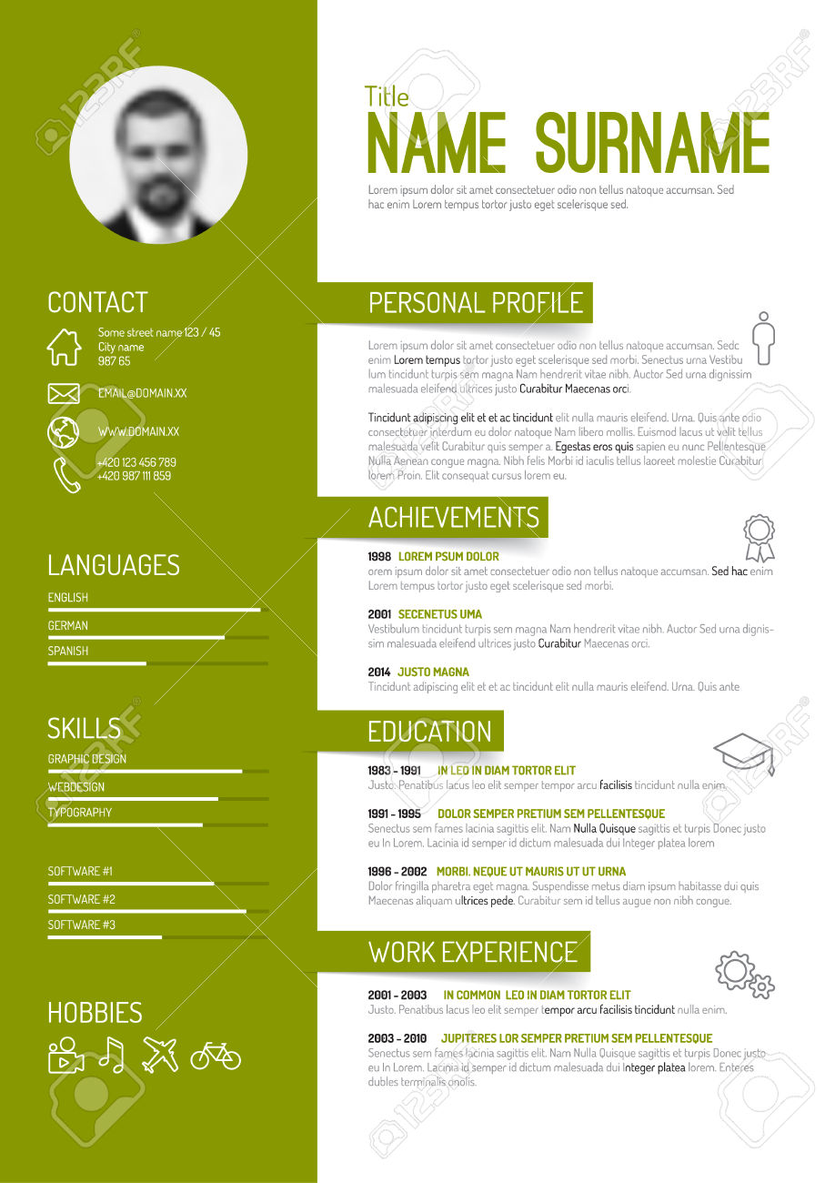


What if I don’t gain paid employment?
You will have developed many skills and have an up to date CV.
Your Job Coach will help you apply for similar roles using platforms such as indeed.
We will work with local agencies such as Inspira for further support after the supported internship.

Slide 12
Thank you.
You will find further information at right2work.org.uk

