Slide 1
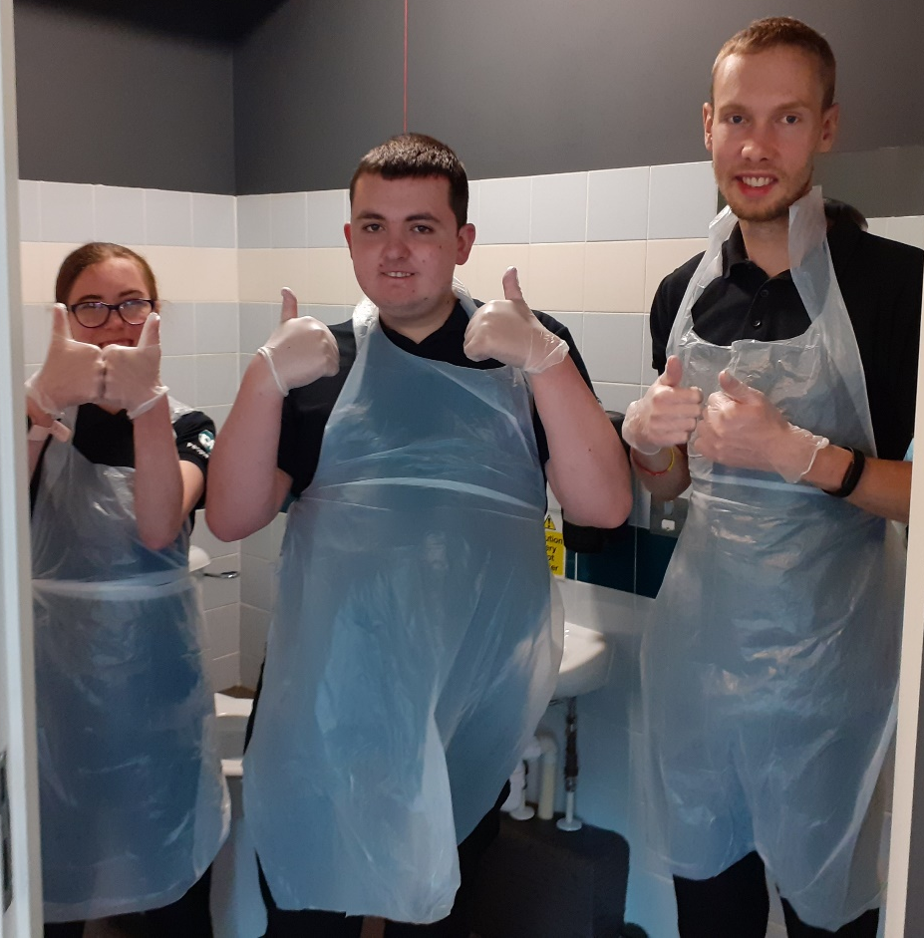
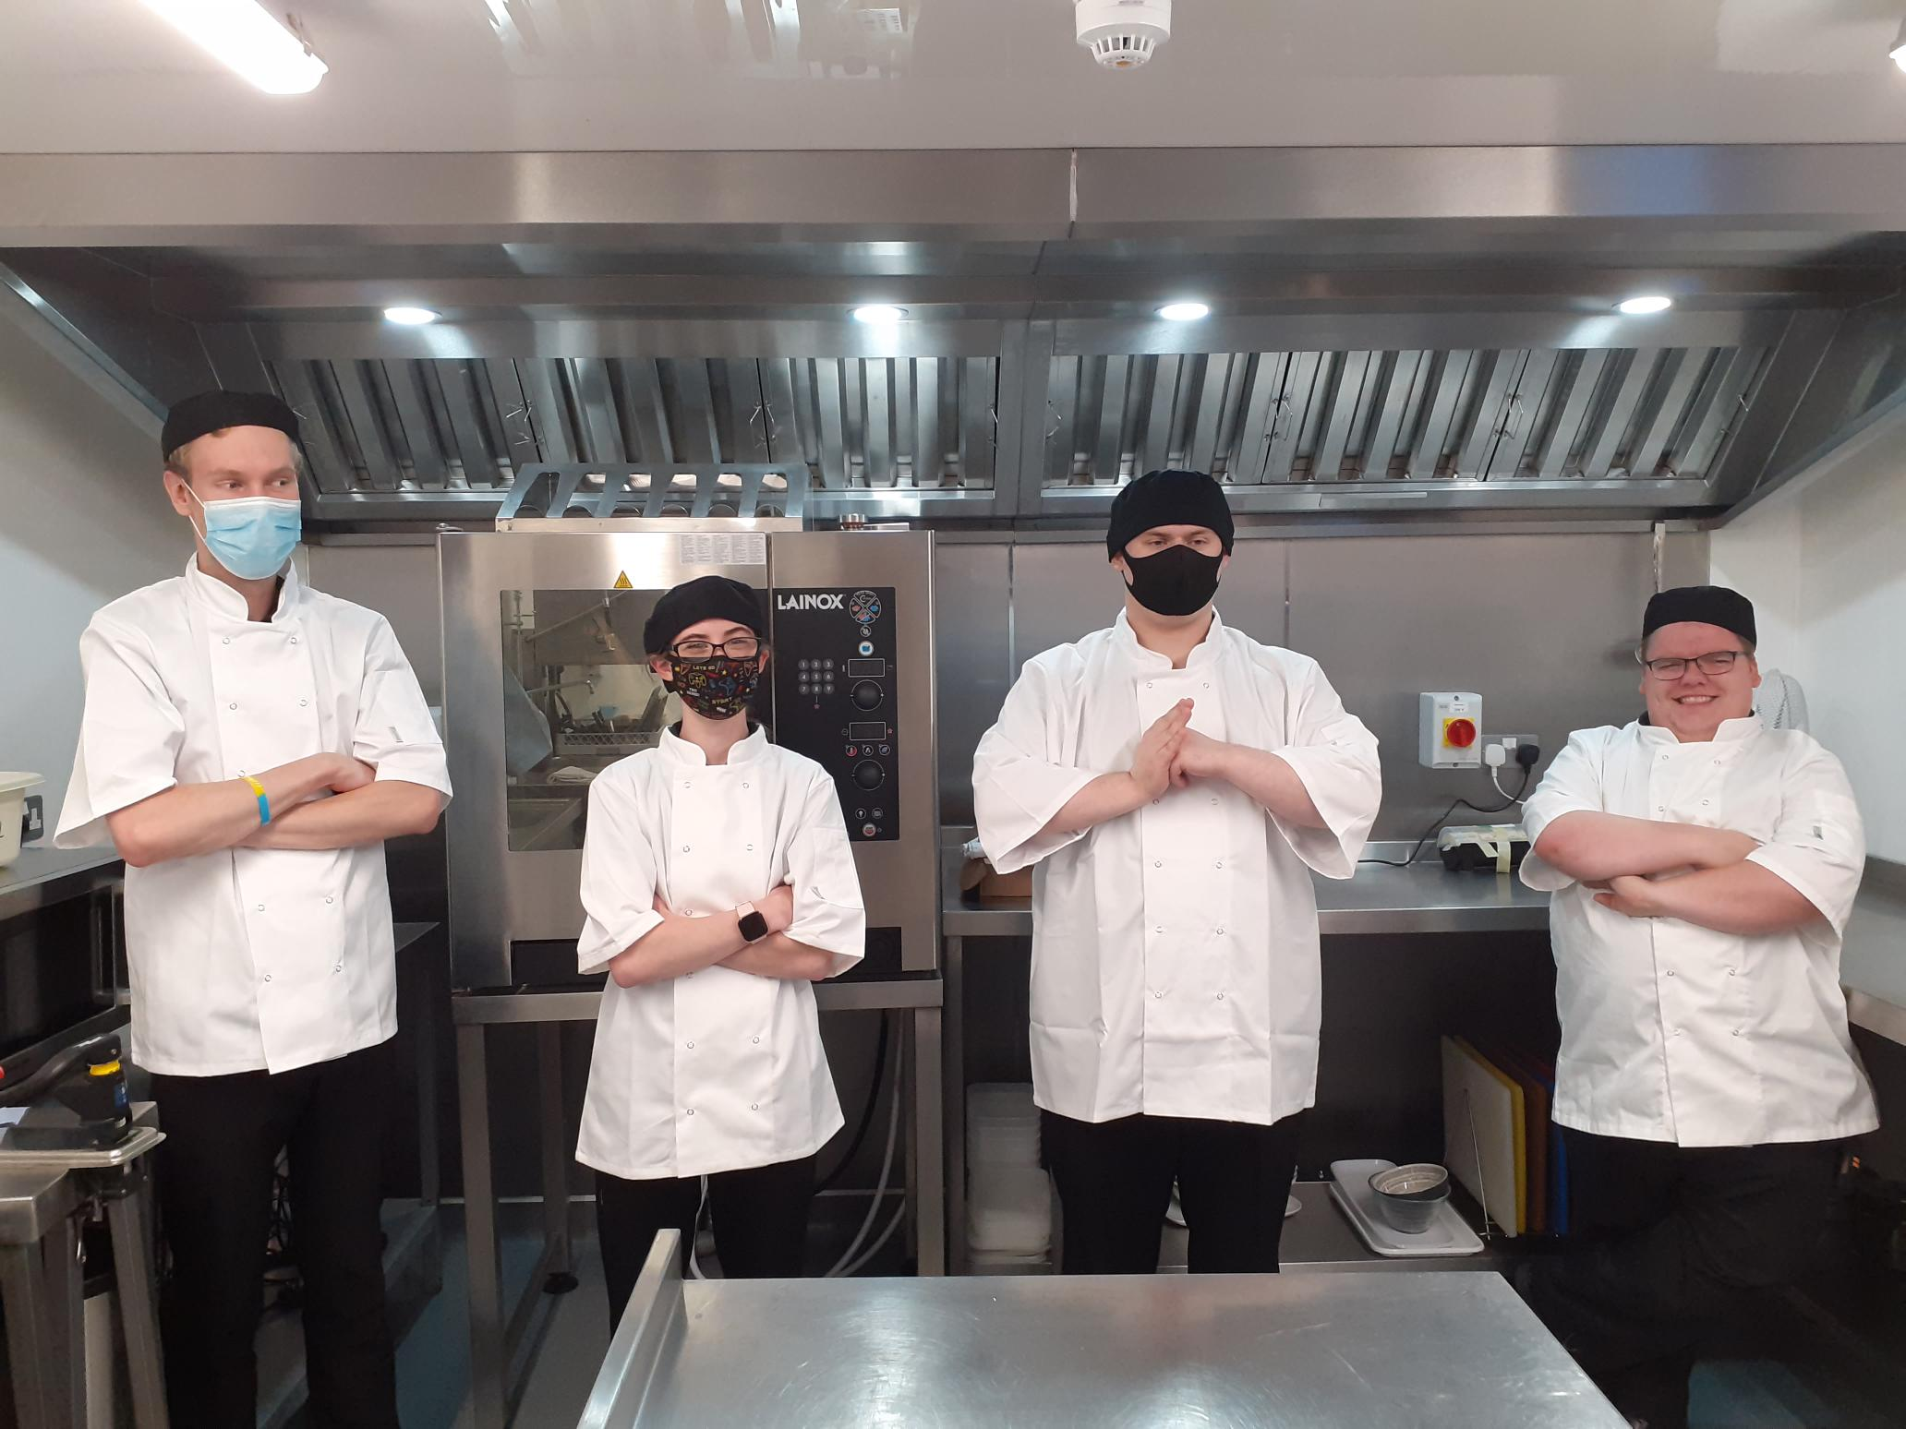
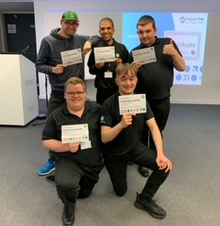
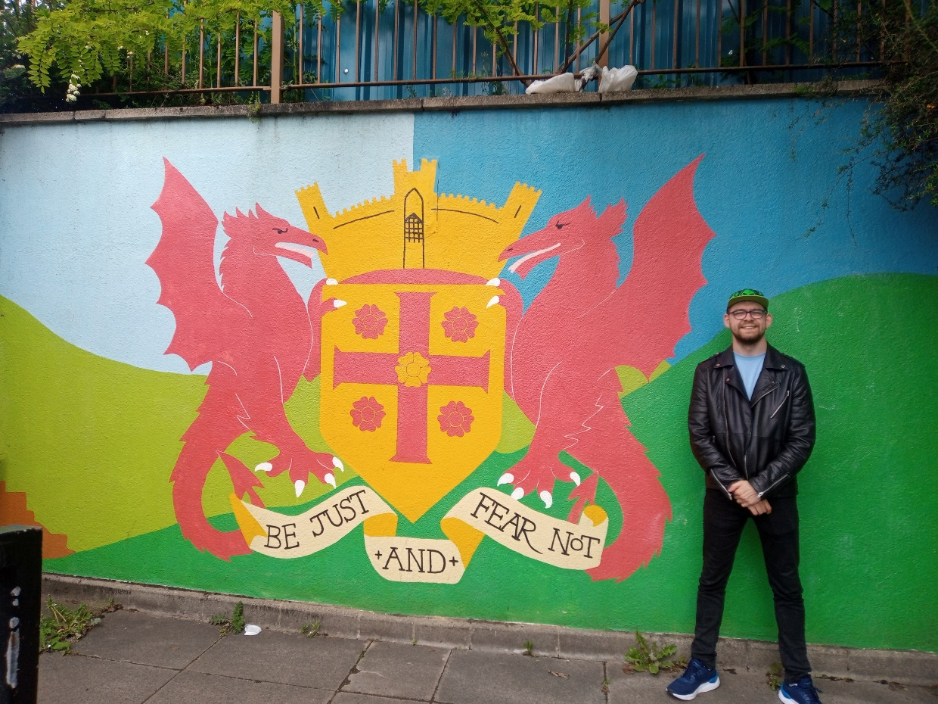
People First
Hospitality Academy and Best Life Programme

Slide 2
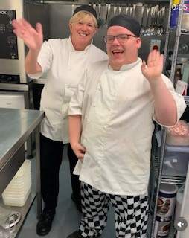
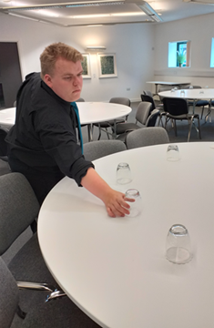
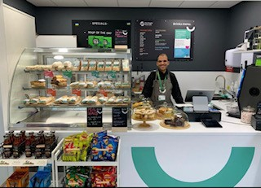
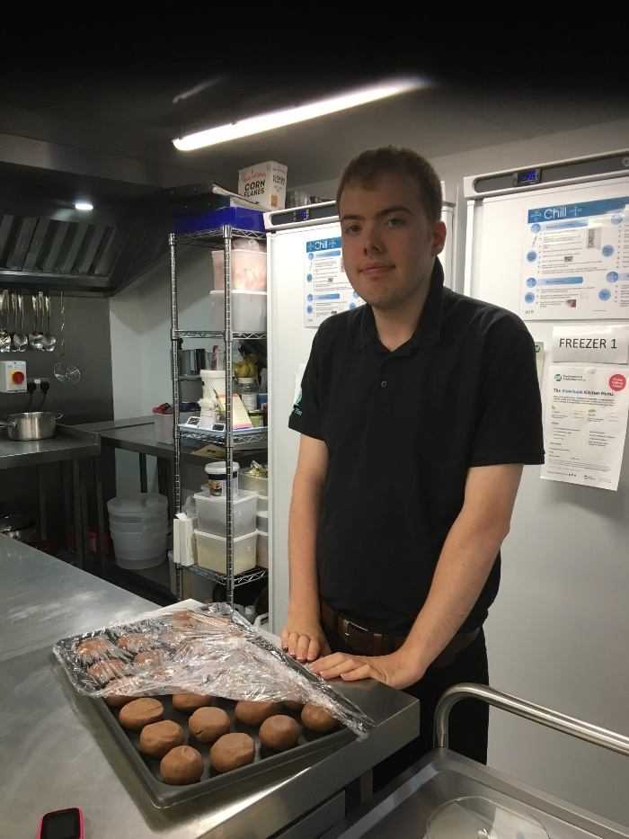
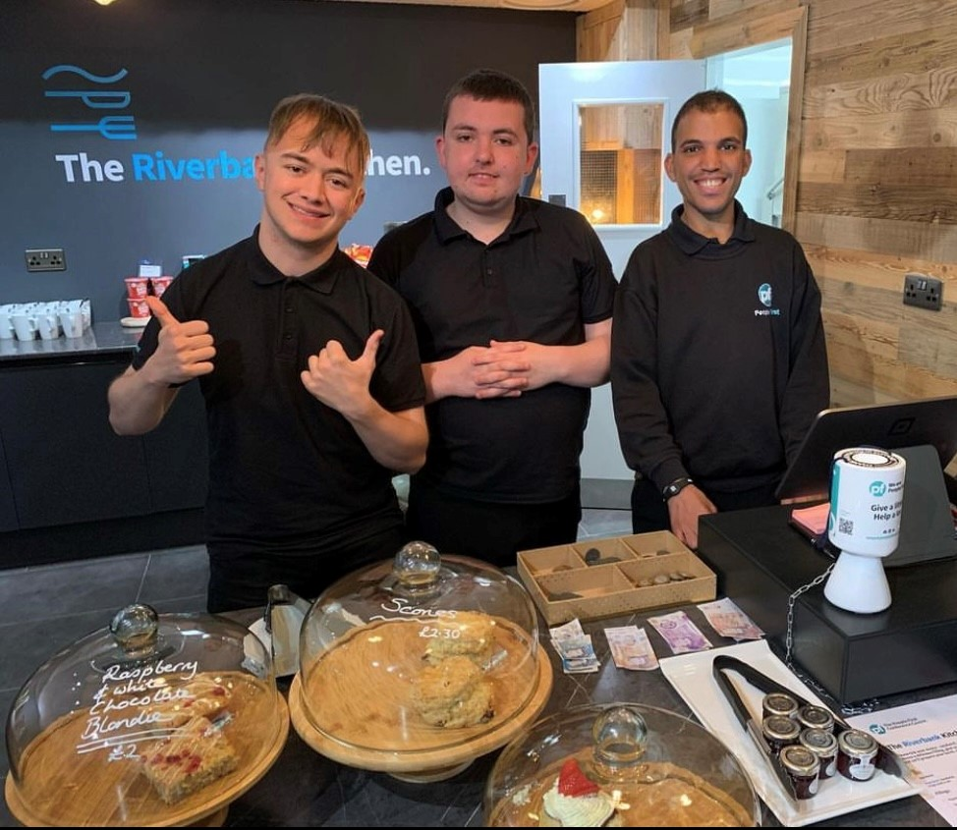
Hospitality Academy
Notes:
Hospitality Academy
An awarding winning, practical course leading to a qualification with Open Awards.
We are based in People First Conference Centre, Riverbank Kitchen and The People First Café in Carlisle.
Learners could talk about what jobs they do ☺
Learners are funded through Adult Social Care Day Services Framework
Learners are currently on a Level 1 Certificate in Hospitality and Catering Skills or Entry Level 3 Certificate in Skills for Further Learning and Employment.
Some of the units we cover are Customer Service, Food Safety & Storage, Using Cooking Skills, Serving Food & Drink, Understanding a Work Experience Placement
Learners are supported by our Job Coaches
Learners can attend the course for up to 3 years
Currently 13 learners on Hospitality Academy

Slide 3

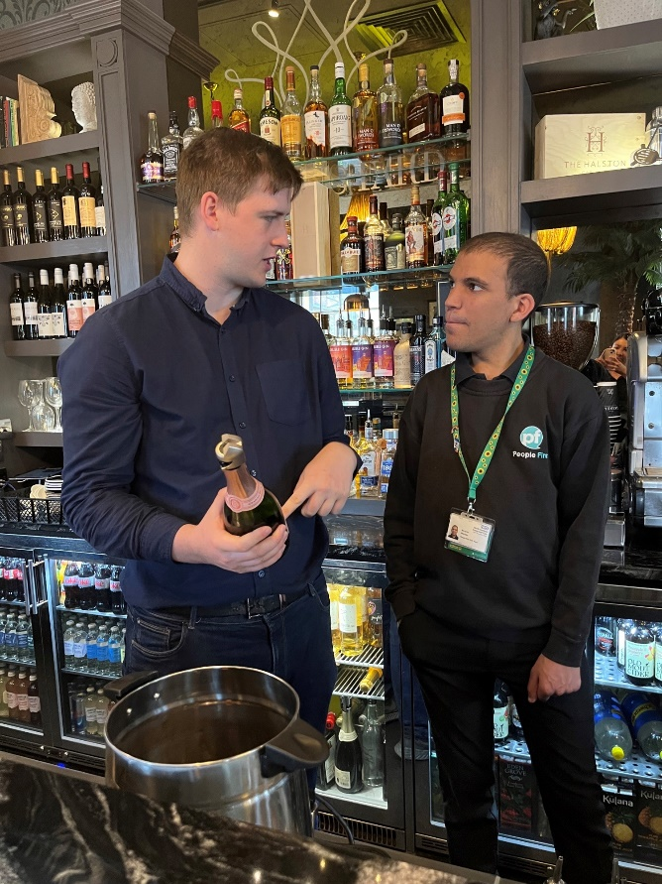
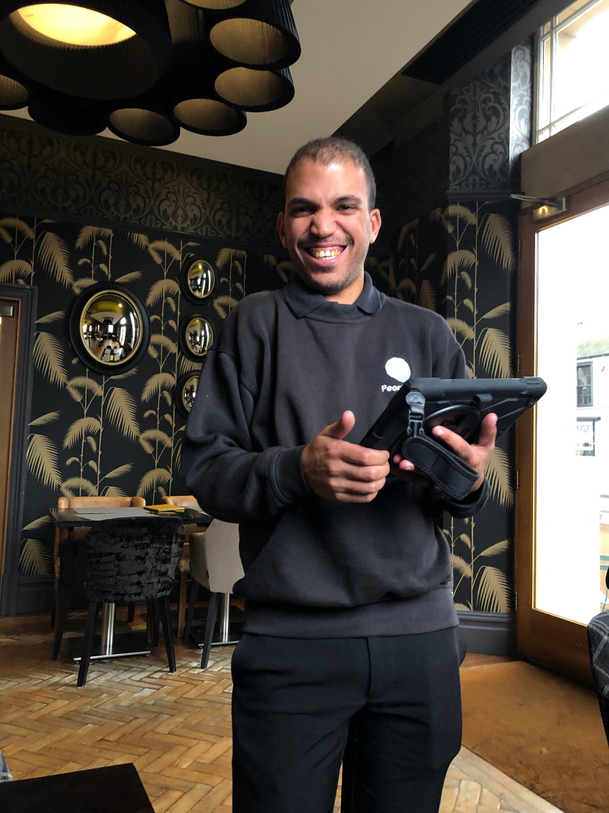
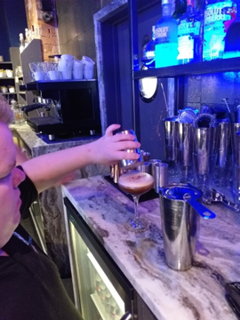
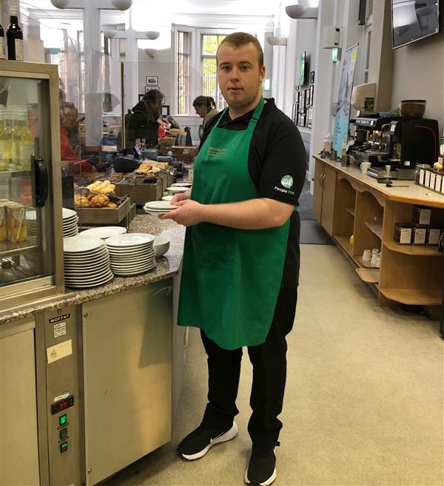
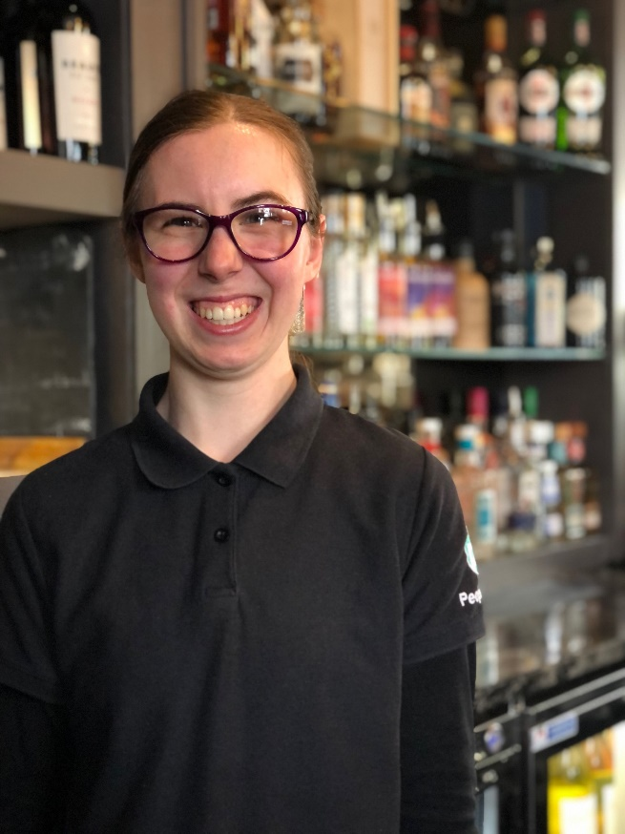
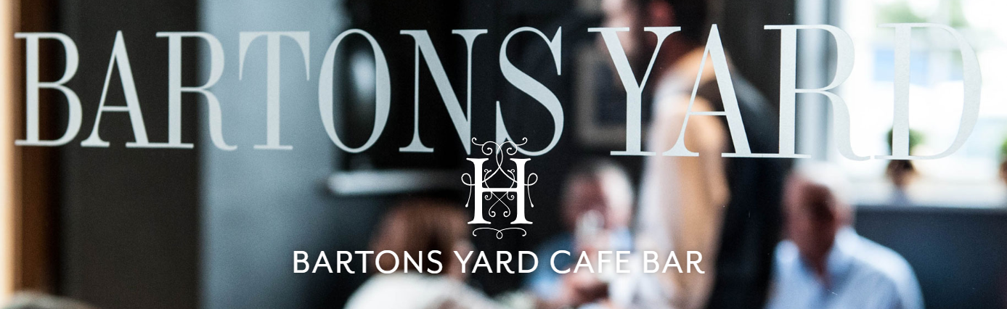
External Work Experience
Notes:
Learners also get the opportunity to go on external work placements with local businesses and organisations with our Employability Job Coach
Learners have been on placements at Bartons Yard a stylish café bar, part of The Halston Hotel in Carlisle; Tullie House café and kitchen, Tullie House Gallery and Oak Tree Animal Charity.
Funding is the same as the Hospitality Academy- through Adult Social Care Day Services Framework.

Slide 4
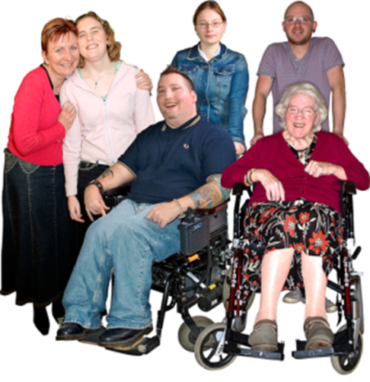
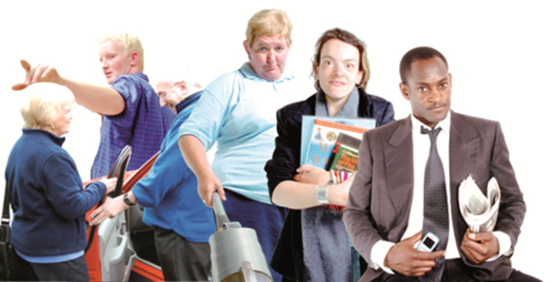
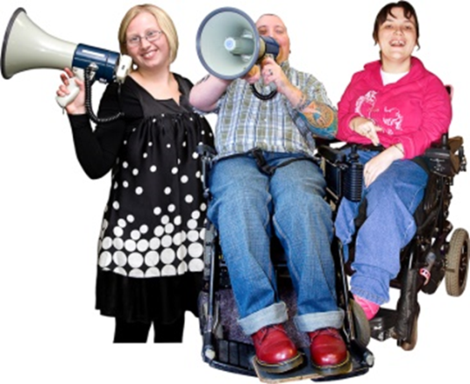
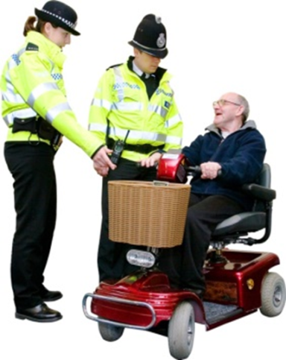
Best Life Programme
The Best Life Programme recognises the importance of having:
Family, Relationships and Love in Life
An Informed, Wealthy and Productive Life
An Expressive and Connected Life
A Safe, Healthy and Well Life
Notes:
Best Life Programme is a non- traditional day opportunity, developed by People First, which supports learners to explore a range of real life opportunities, experiences and educational learning to understand better what “Living your Best Life” means.
Workshops based in People First Conference Centre focusing on the 4 principles shown above.
We also often head out into the local community to attend events and have visited places such as:
Carlisle Castle
Carlisle Cathedral
The Old Town Hall
Tullie House
The Art Trail
We are a member of Learning Disability England and attend their online webinars and get involved in training opportunities for example we are currently doing a Level 1 Makaton course
Also works towards an accredited qualification- Independent Living in the Community which includes the following units
Living in the Community
Self Advocacy
Understanding Rights & Responsibilities
Understanding Relationships
Healthy Lifestyles
E-Safety
Accessing Financial Support
Accessing Support Services
Hobbies
Adult Social Care Day Services framework
Best Life is a 2 year course. 3 days a week (Tues, Thurs, Fri)
Currently 3 learners on the Best Life course

Slide 5
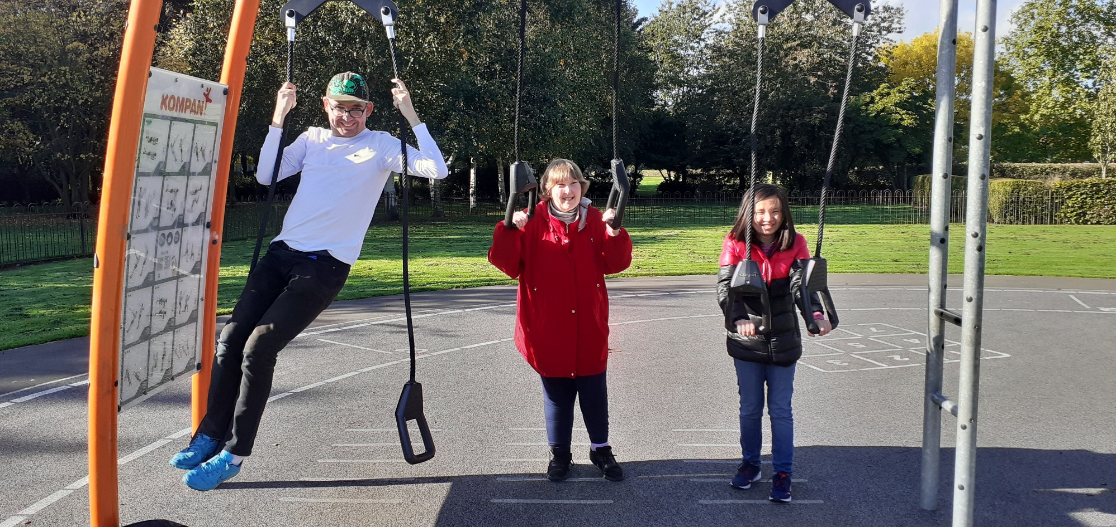
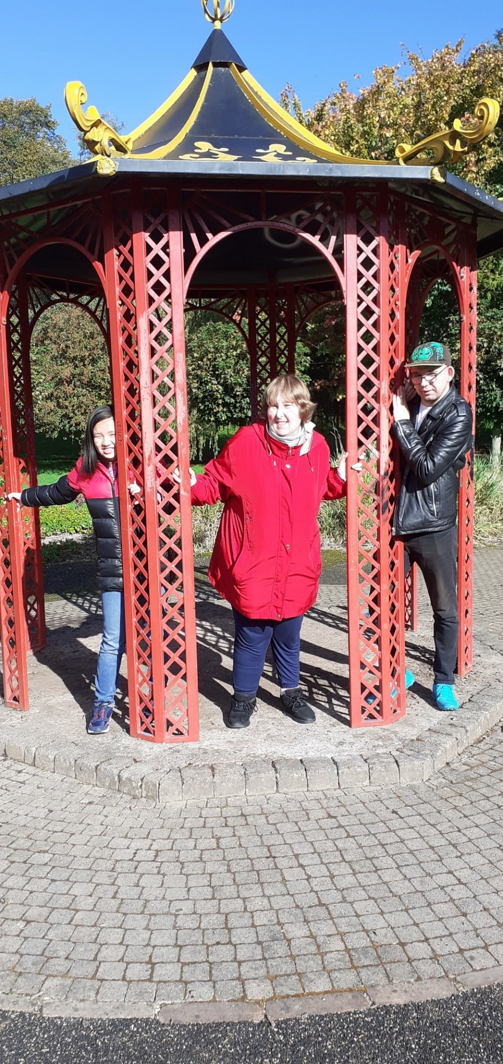
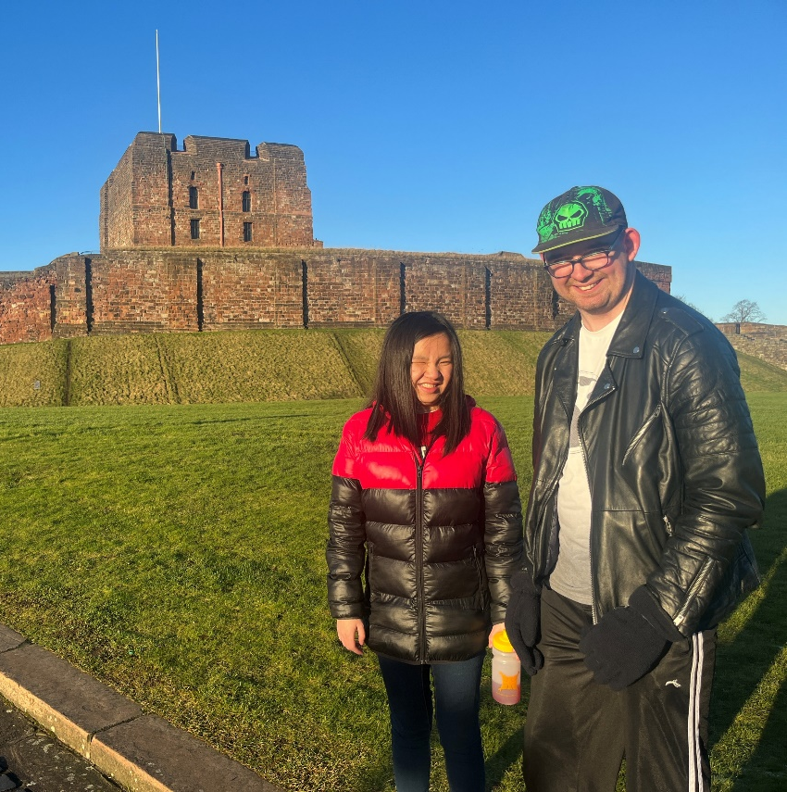
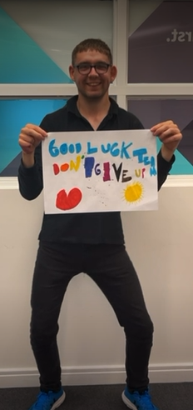
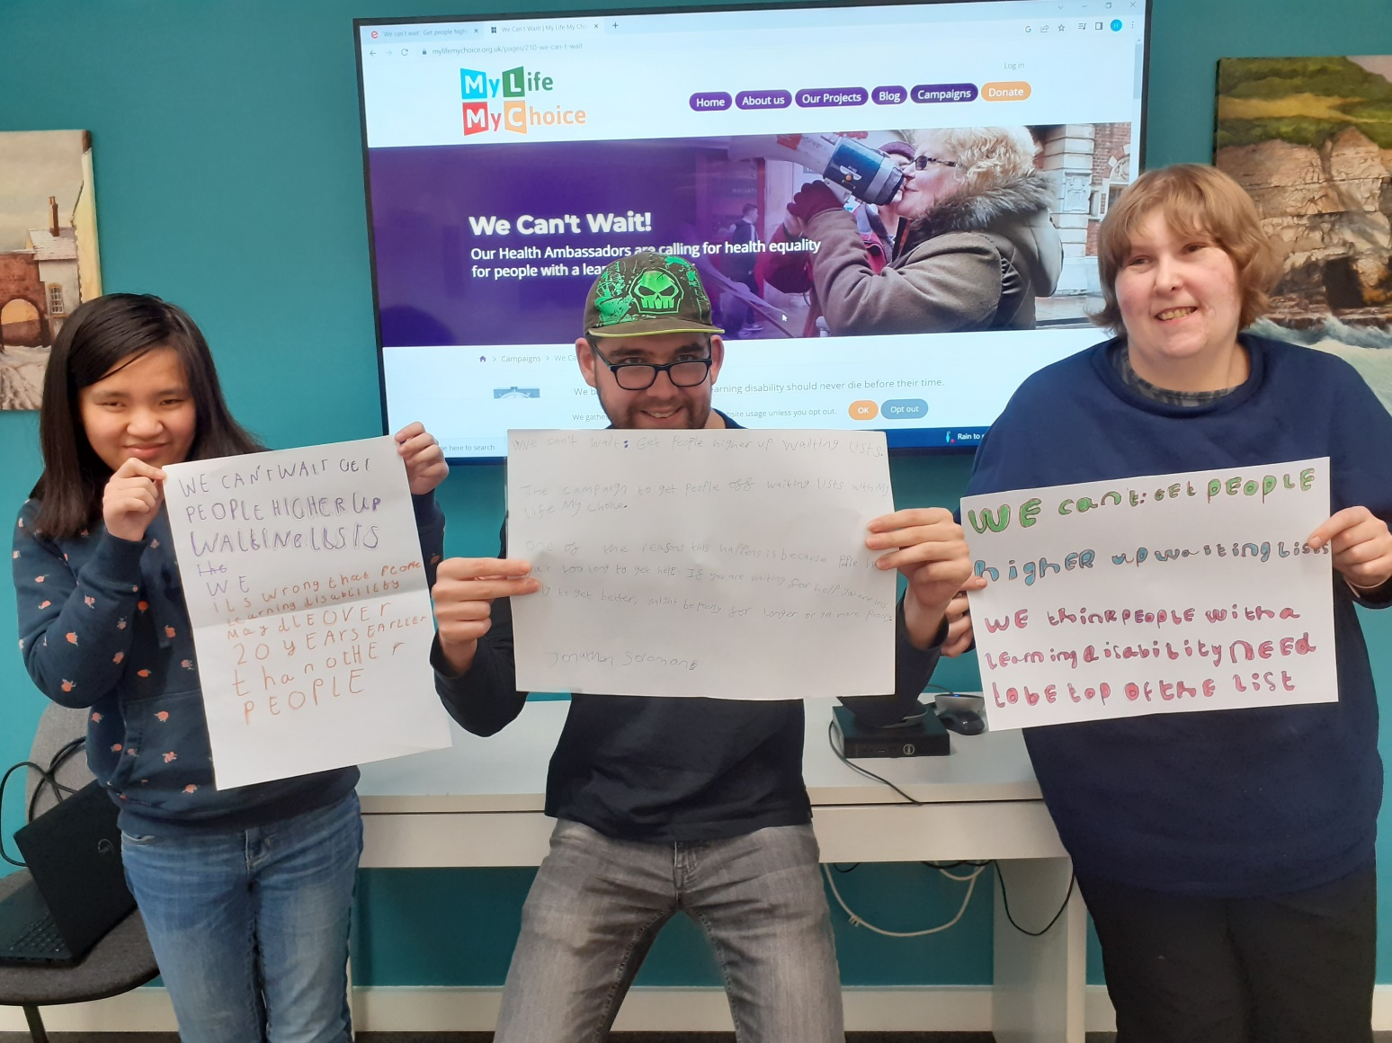
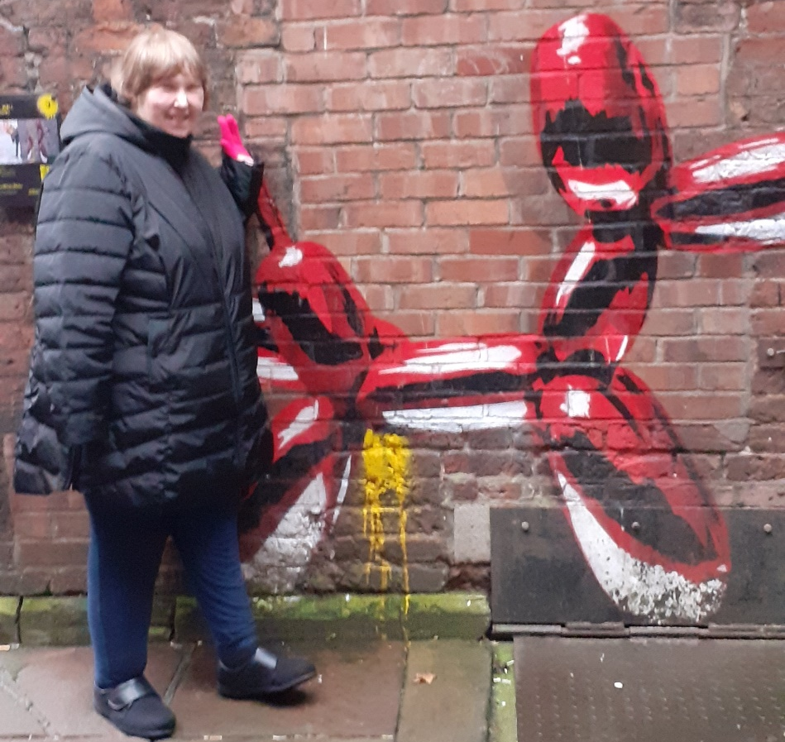
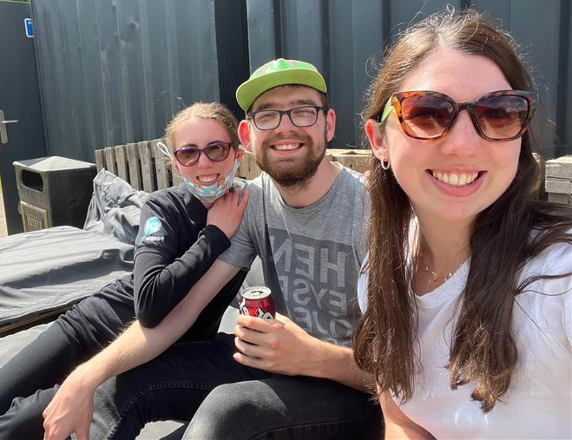
Notes:
Photos of some of the trips out with Best Life.
Outdoor Gym at Bitts Park
Carlisle Art Trail

Slide 6

Feedback from Learners and their parents/carers
“Attending People First has been an overwhelmingly positive experience. Working in a professional environment while feeling supported has been incredibly helpful”- Hospitality Academy Learner
“My son really enjoys going to People First. He has grown in confidence enormously and is noticeably more relaxed with others in social situations too.”
“My son loves coming to People First. It’s really helped him grow in confidence and independence”
“The People First staff I work with are friendly, kind and the course is interesting.”- Hospitality Academy Learner

Slide 7

Question and Answer Session
Any questions?
Education and Research Team

