Slide 1


Career Team at

Slide 2
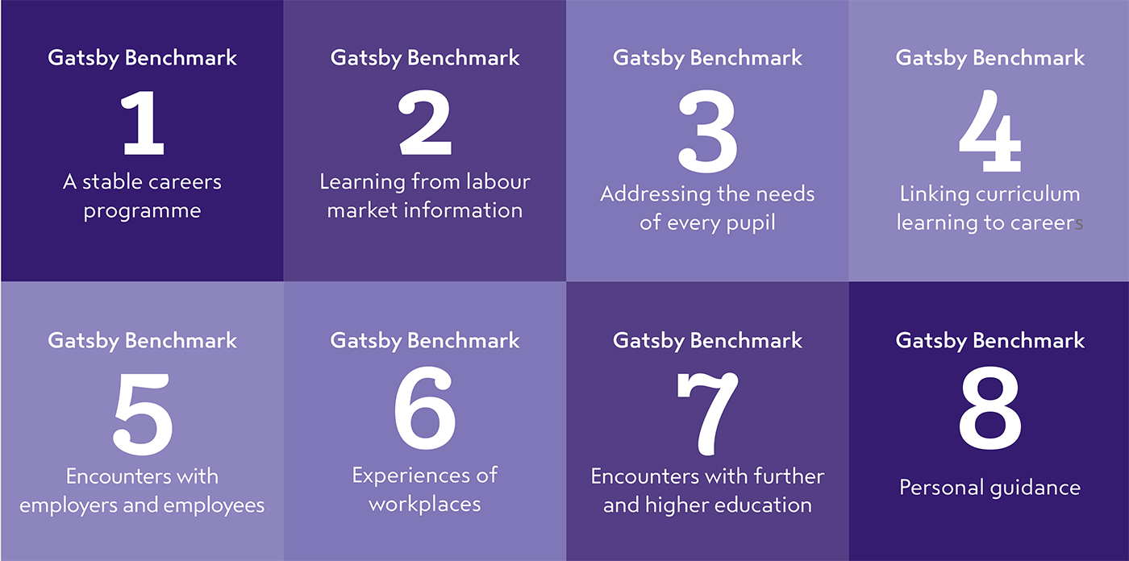
Gatsby Benchmarks
When?
Why?
What does it mean for us?

Slide 3
Career pathways at James Rennie
For pupils working on pre-formal curriculum the pathway is concentrating to enrich the life experience by developing communication skills, meaningful relationships, social and community life and actively participate in activities personally enjoyed and with people they like to spend time with.
For pupils working on semi-formal curriculum the pathway is concentrating to improve work related skills for independent living.
For pupils working on formal curriculum the pathway is concentrating to improve the possibility and probability of paid work by classroom-based career coaching, exploring career options, work experience, meeting employers, enterprise skills and work related accreditations and qualifications.
Young people At James Rennie School are given opportunities to gain appropriate and relevant accreditations that recognise their skills and aspirations for the future.
Pre-formal students
Semi-formal students
Formal students

Slide 4
How do we as a school develop ‘career’ skills across the key stages?
Communication Skills
Functional Skills
Living Skills
Independence Skills
Self Regulatory Skills

Slide 5
Developing “career” skills across Key Stages
Group exercise…

Slide 6
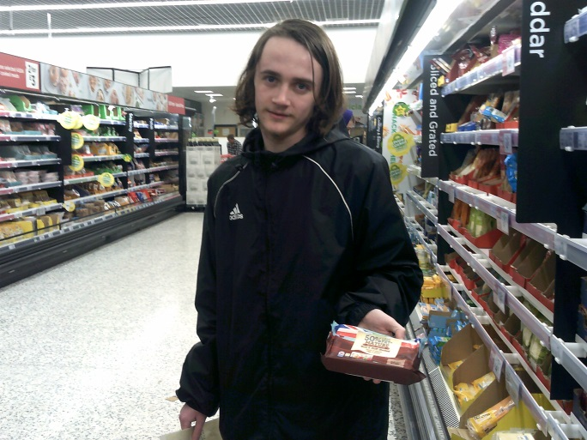
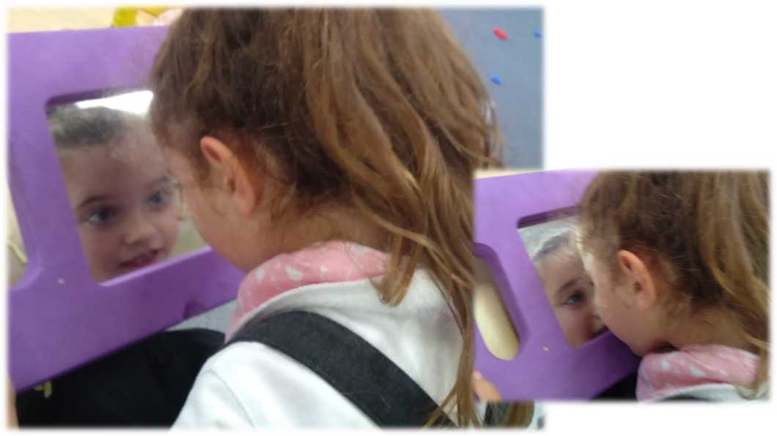
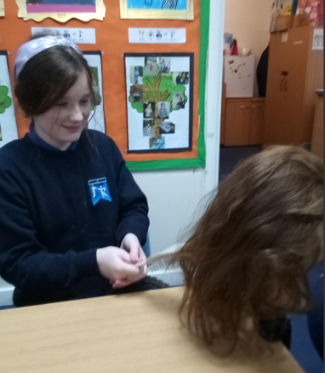
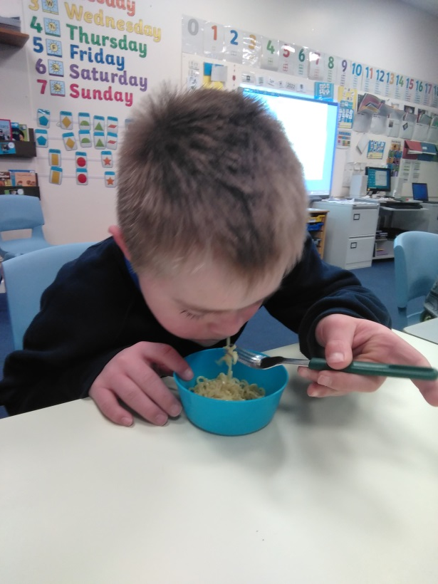
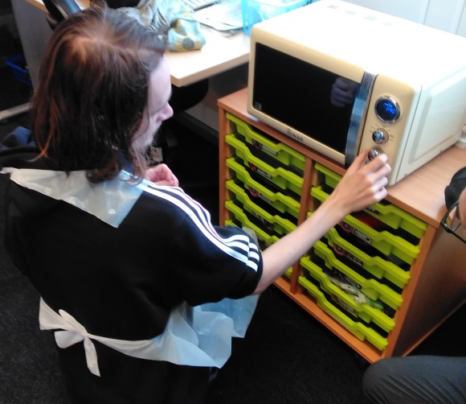
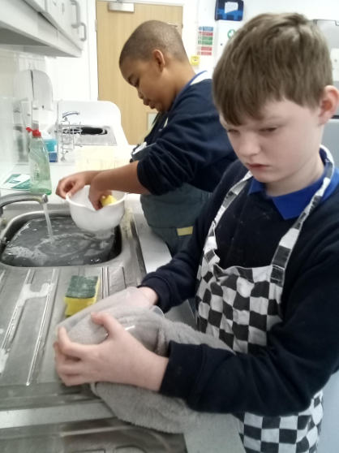
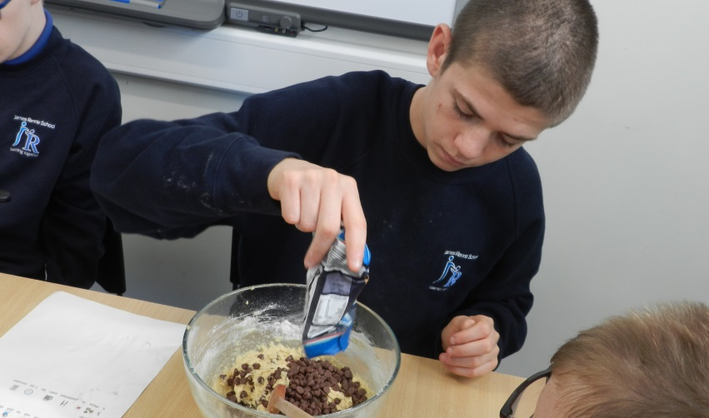
Career skill development happens everyday at James Rennie

Slide 7
What’s next?
Thinking about life after

Slide 8
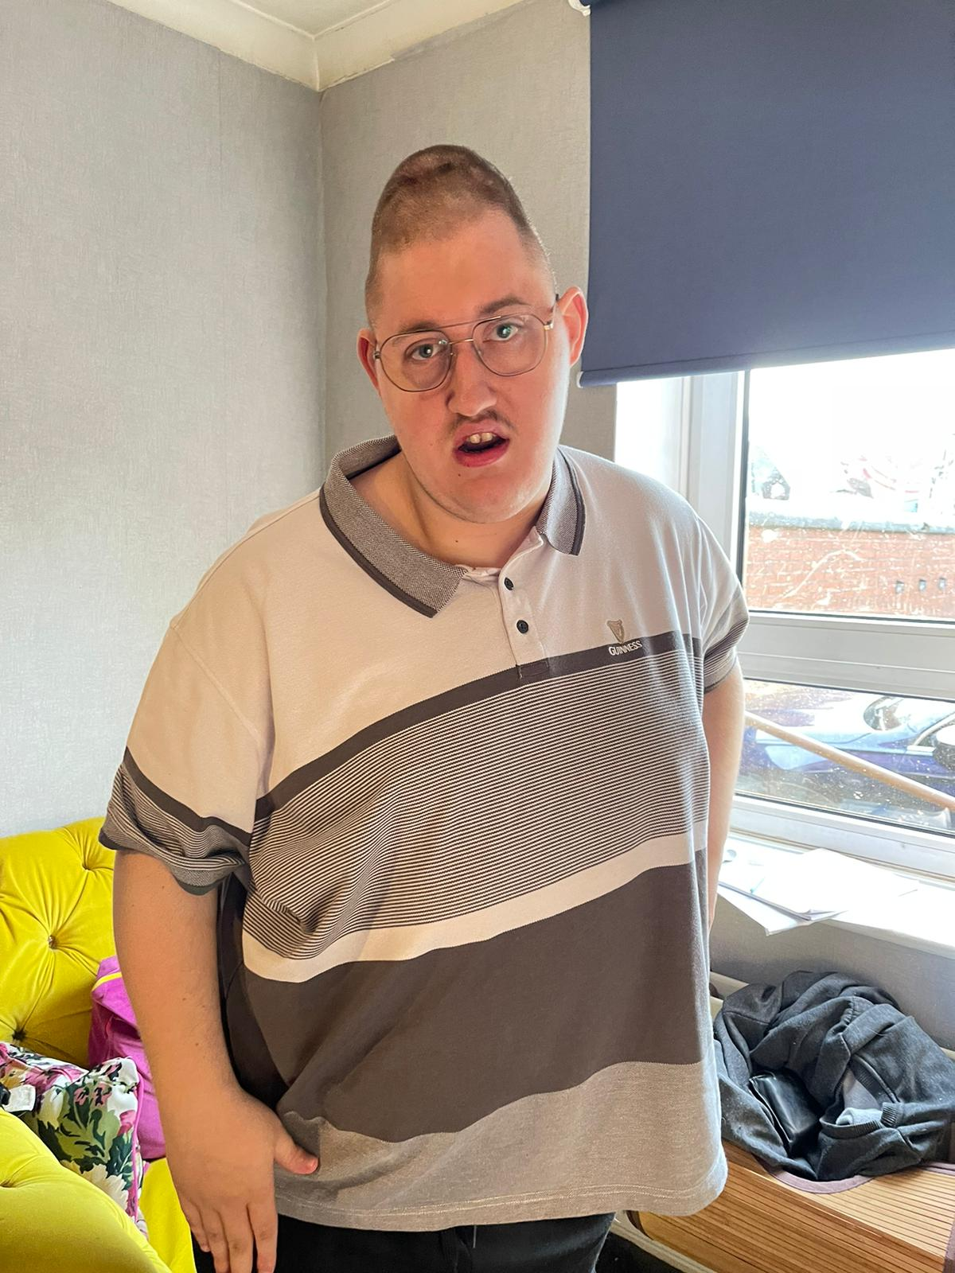
Hi, My name is John, and I am a former student of James Rennie School.
I went to Beaumont College in Carlisle when I finished James Rennie School. I stayed there for two years. It was four days a week course, and I enjoyed my one day off staying at home.
My favourite activity at Beaumont College was Plan, Shop and Cook. Every day, we had to think about what to cook for our lunch, go shopping and then cook it. I really enjoyed it!
In my last six months at Beaumont College, I worked at the café at Morton Manor Community Centre. I loved talking to people and serving them cakes! I finished college in July 2022.I attend activities at Heathlands twice a week, but I would like to be there four days a week and join the Boccia league!
On Fridays, I go to Harraby Community Centre to Keep fit with Cake! Sessions. I attend the seated aerobic session and then join others in a café for a cake! I have many friends there, and as you probably know, I love to chat, so meeting people from different places around Carlisle is my cup of tea!
And most importantly, I am still seeing Ann for our weekly adventures! We are a match made in heaven!

Slide 9
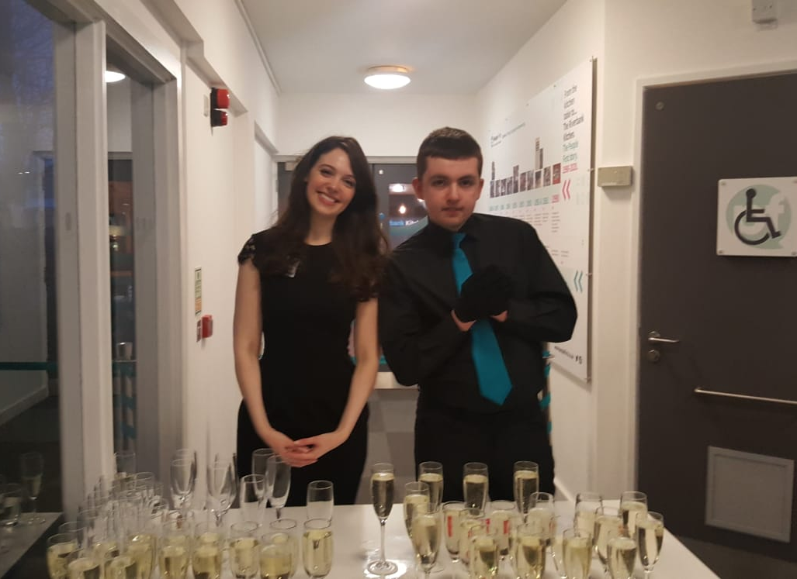
Hi, my name is Kieran, and James Rennie School was my home for most of my teenage life! After graduating from James Rennie, I started the New Horizons course at Carlisle College and completed it in the summer of 2021. The course was three days a week.
At the same time, I also started a Hospitality course at People First for two days a week. I am still at People First! At first, I was working in the Riverside café at the People First centre, which I enjoyed, but at the moment, I am finding working in a café a bit too hard and overwhelming. So I moved to do jobs at the conference Centre, but I am hoping to go back to work in the café when I feel better!
Once a week, I go to Wholefoods Shop in Wigton, which Chrysalis runs. I work as a customer assistant, and my work includes weighing, labelling and serving customers. It is a reasonably quiet shop, and I like that! I also meet my support worker once a week, and we enjoy our outings. We do a lot of walking that I really love. As you may remember, I was part of DofE at James Rennie School. My favourite route is Keswick to Threlkeld Railway Path. I also like baking at my support worker's house and visiting Keswick to look at shops!

