Slide 1
High Needs Study Programme
Through Cumbria County Council Adult Learning

Slide 2
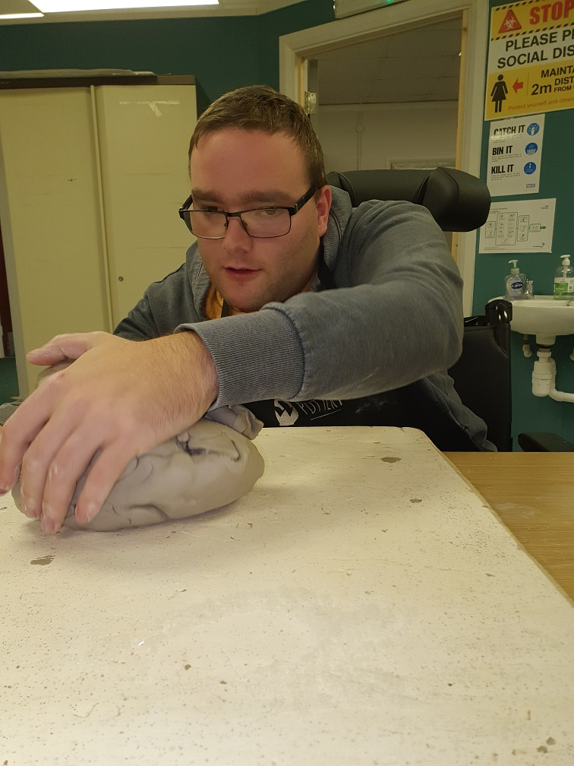
Delivery
Bespoke
16 hours per week term time only
Learners aged 19-25 with an EHCP
HNSP must be able to meet need
10 places 2023

Slide 3
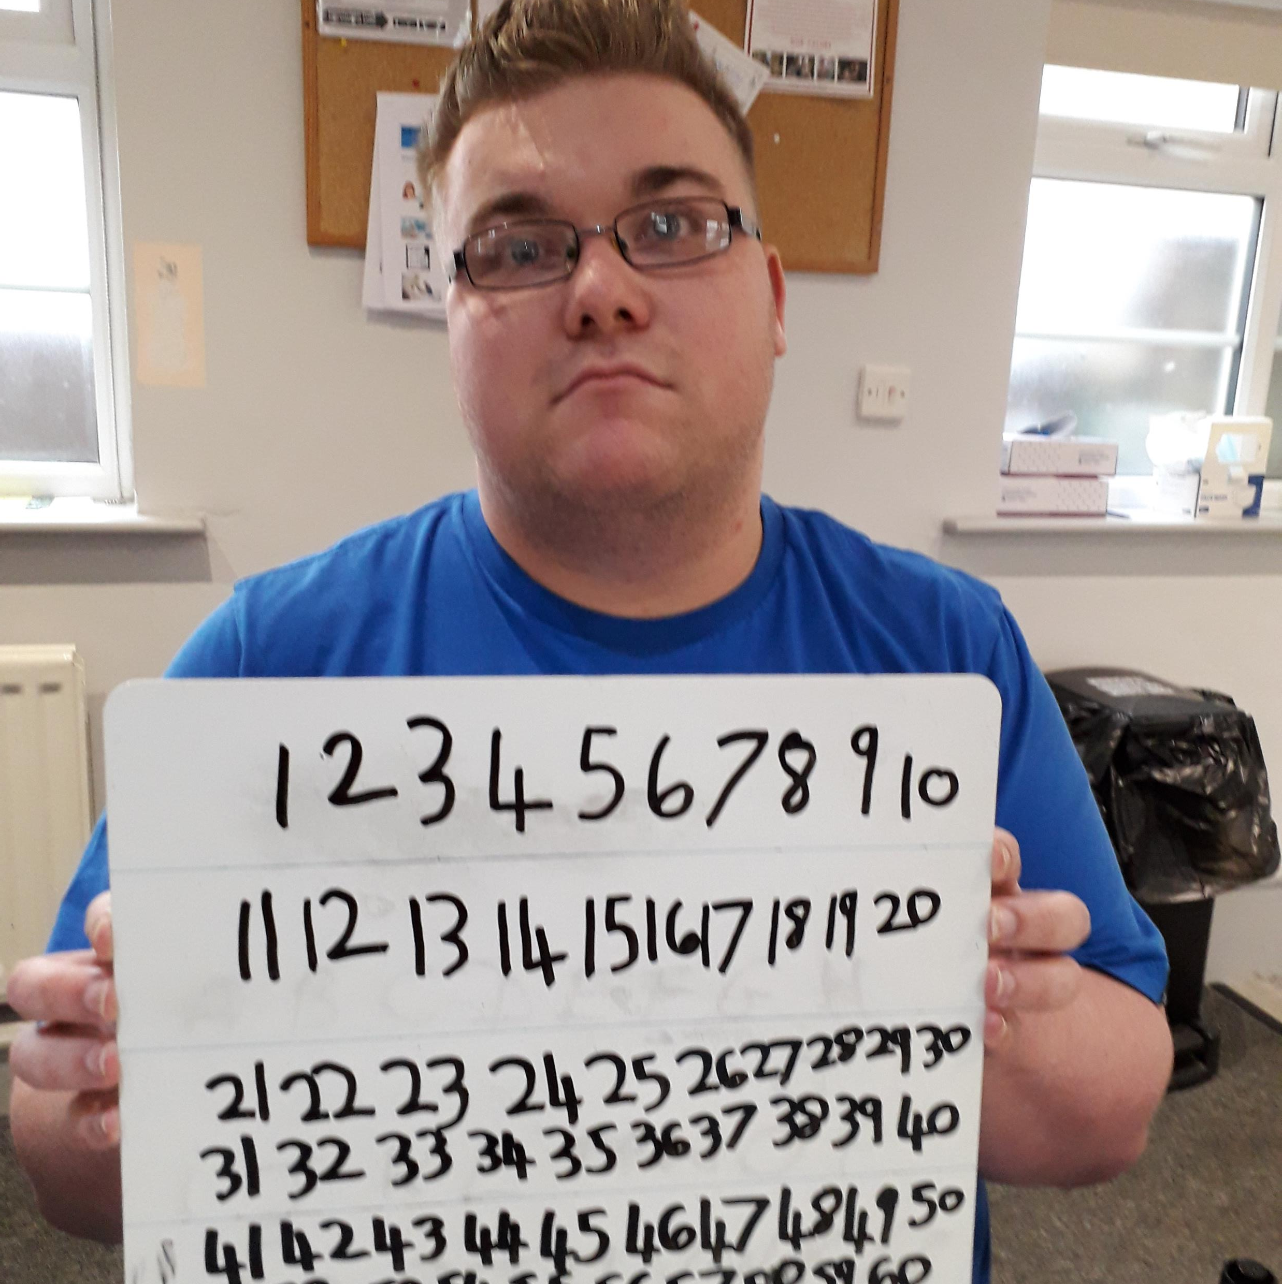
Programmes
Maths and English
Independent living
Confidence and communication
Adulthood
Portfolio Qualification
EHCP Targets
Employability experience
1-2-1 and/or group education

Slide 4

Partners
Right to Work
United Response
Heathlands
Prism Arts
Day Centres
COSC
Westhouse – Pottery, Café West, Allerby Gardens
Susan’s Farm
Independent work placements

Slide 5
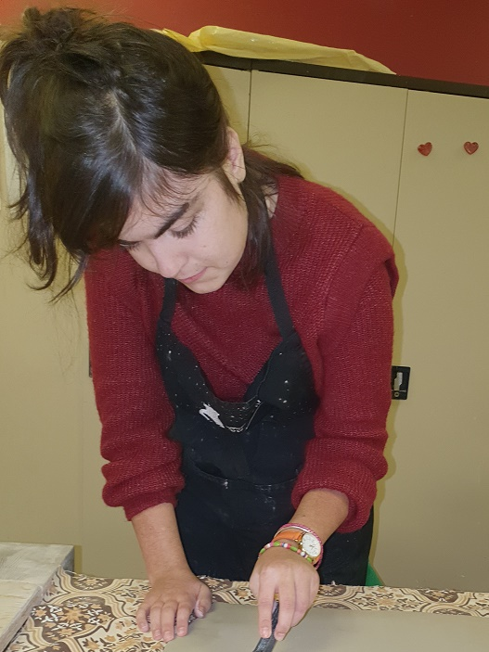
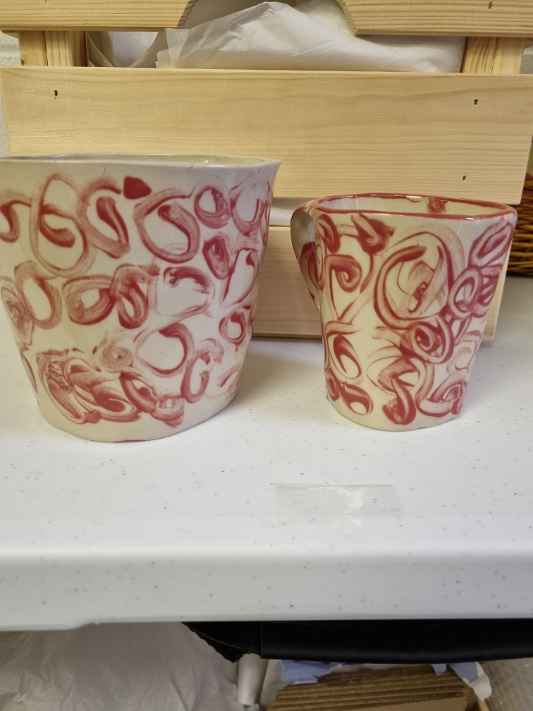

Slide 6
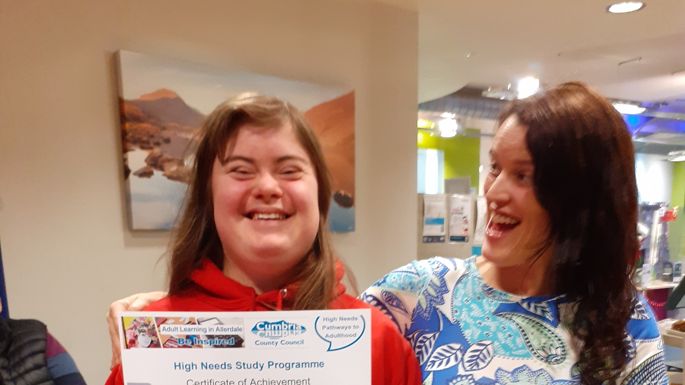

Slide 7
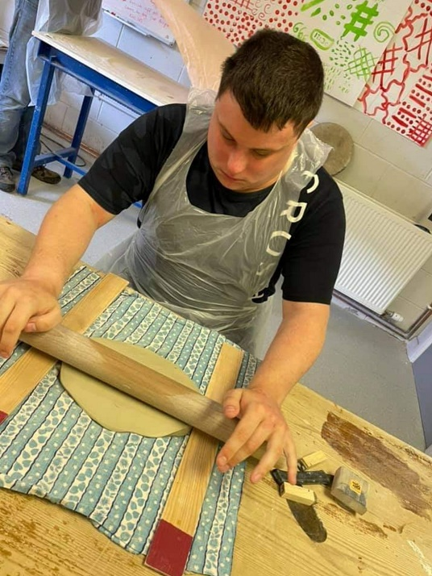

Slide 8
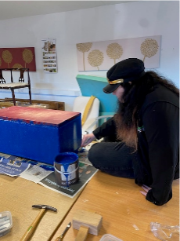
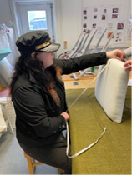
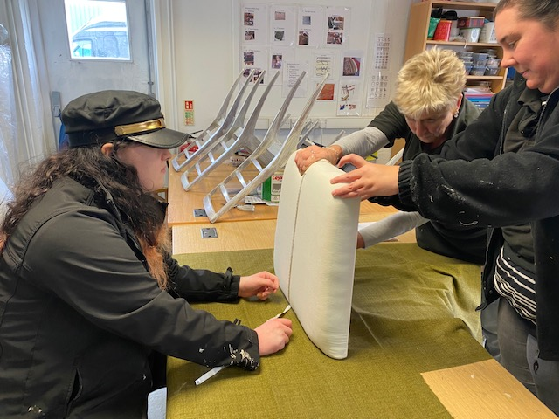

Slide 9
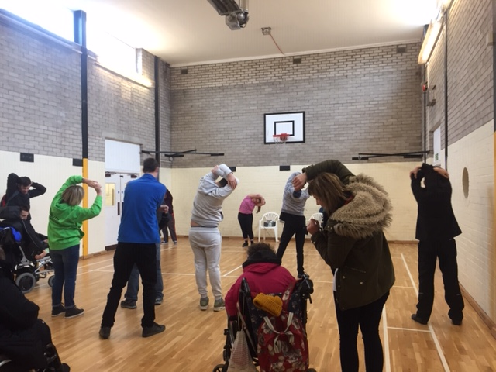
Health
and
Wellbeing

Slide 10





Any questions

